Slide 1
Myotonic Dystrophy
Respiratory Complications
Mike Czervinske RRT-NPS
University of Kansas Medical Center

Slide 2
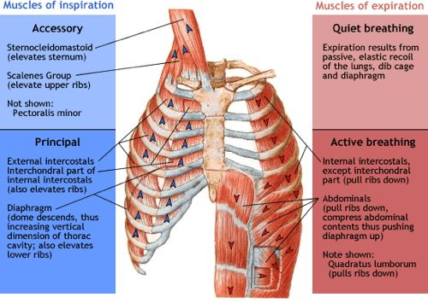
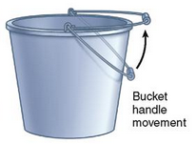
The Respiratory System
Diaphragm Movement
From: Tidy’s Encyclopedia of Physiotherapy

Slide 3
It’s Not About Oxygen It’s About Ventilation Air in CO2 Out
Air In
CO2 Out

Slide 4
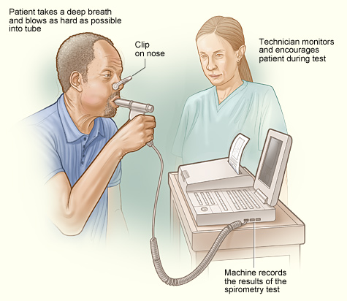
Pulmonary Function Testing
“PFT”
Spirometry
FVC
FEV1
FEV1/FVC
80-100% of predicted (Normal)

Slide 5
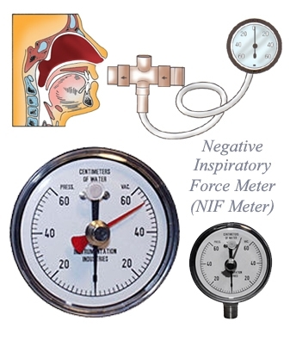
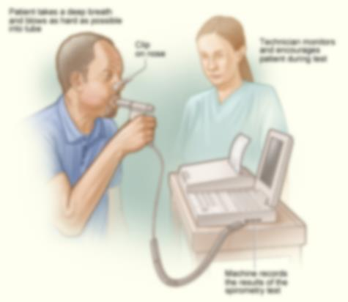
Pulmonary Function Testing
Breathing Help
Usually required < 50% predicted
Not sole criteria
NIF/MIP
>60 cmH2O normal
SNIF
>40 cmH2O normal

Slide 6
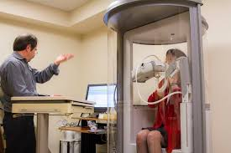
Other Tests
Sleep Study
Overnight oximetry
Chest X-ray
Complete PFT

Slide 7
When You Need Help With Breathing
FVC < 50%
NIF < 60 cmH2O
SNIF < 40 cmH2O
Daytime sleepiness/morning headaches and other signs of sleep apnea
Difficulty with cough or choking
Shortness of Breath

Slide 8
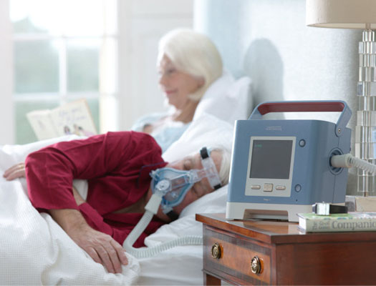
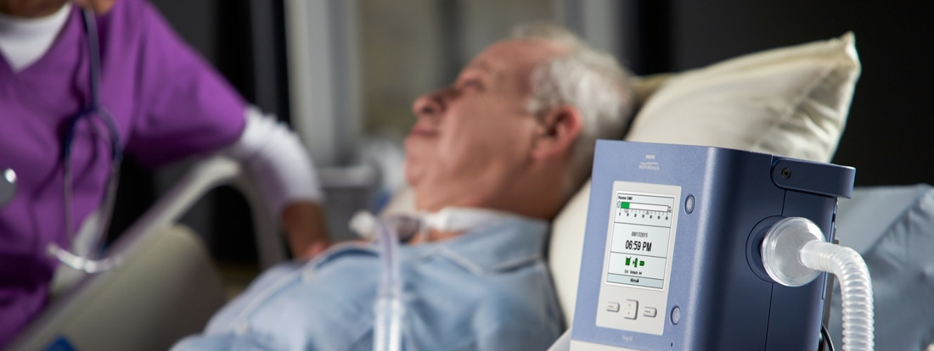
Trilogy
Noninvasive Ventilation
Invasive Ventilation
Portable
Ventilator
Modes

Slide 9
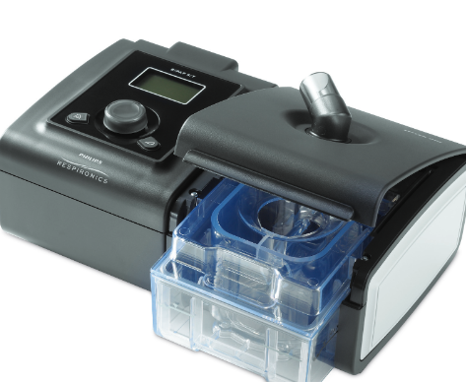
BiPAP AVAPs
Sleep Apnea
Night time, naps, and as needed
Night time use helps daytime WOB

Slide 10
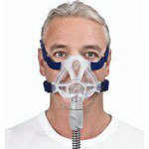
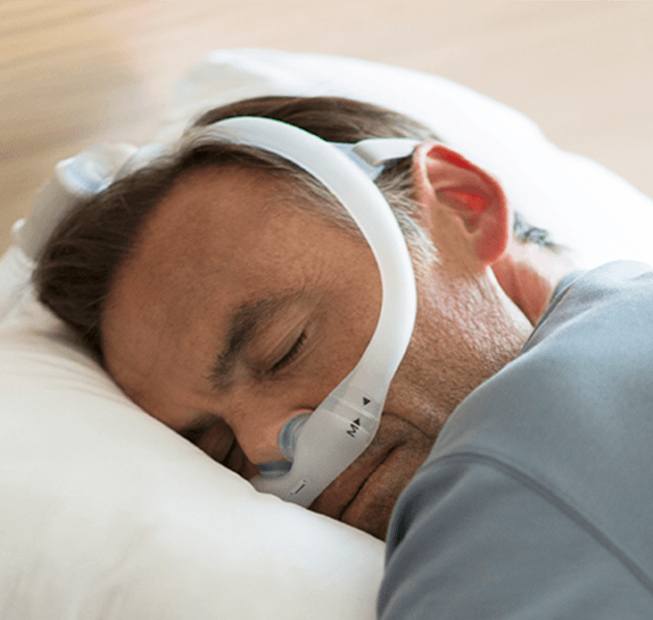
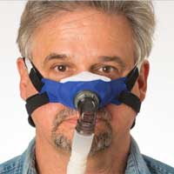
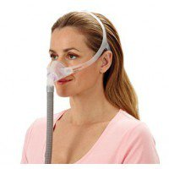
Patient Interface / Masks
Goal is comfort
What ever works for you
Many, Many Options
Most require a full face mask
Due to facial weakness

Slide 11
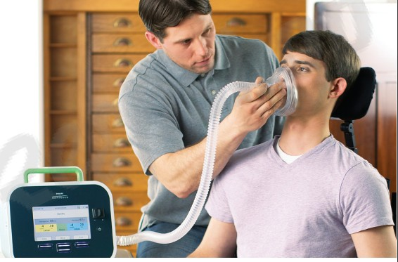
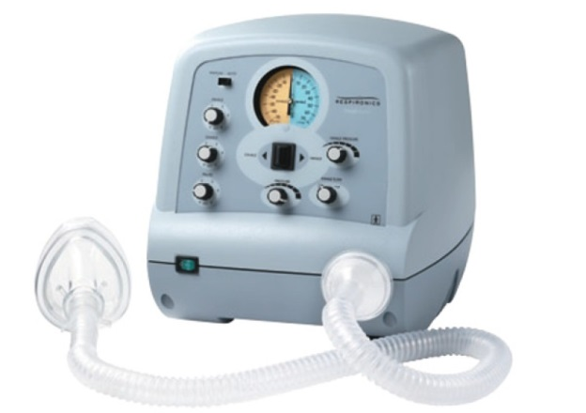
Cough Assist
Gives a deep breath
Vacuums or pulls out secretions
Very effective in most people

Slide 12
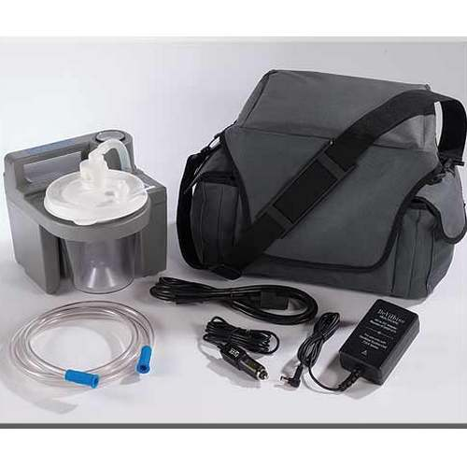
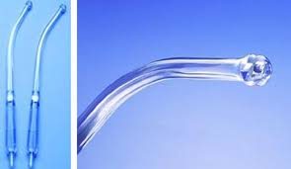
Oral Suction
Just like the dentist uses
Clears secretions from mouth
Not meant to gag you

Slide 13
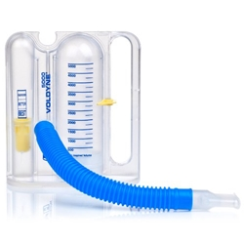
Breathing Exercises
Incentive Spirometer
Cough Assist
Deep Breathing
Deep Breaths
Yoga
Breath Stacking
Aids with cough volume

Slide 14
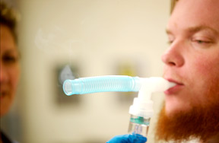
Other Breathing Treatments
Usually for inside the lung problems
Wheezing
COPD
Helps with complications such as pneumonia

