Slide 1

2019 Myotonic Annual Conference
September 13-14, 2019
Philadelphia, PA

Slide 2
Family Planning
Tanya Bardakjian, MS,LCGC
Senior Genetic Counselor, Neurology
University of Pennsylvania

Slide 3
Genetic Counseling
What is it?

Slide 4
Genetic Counseling
The process of helping people understand and adapt to the medical, psychological and familial implications of genetic contribution to disease
The process integrates:
  Interpretation of family history to assess chance of occurrence or recurrence
  Education and inheritance, resources and research
  Counseling to promote informed choices and adaptation to condition

Slide 5
Genetic Counselors
Health care professionals with specialized graduate degrees and experience working in the areas of medical genetics and counseling
Provide information and support to families who have members with a genetic disorder or who may be at risk for a genetic disorder
Serve as support and resource for other healthcare providers
Participate in clinical research

Slide 6
Genetics 101
A Brief Primer

Slide 7
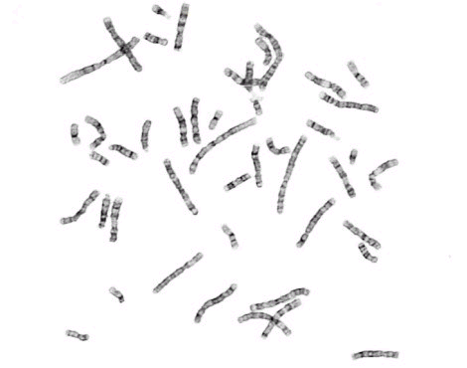
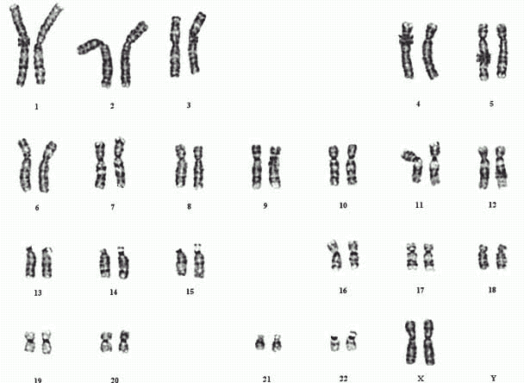
Chromosomes

Slide 8
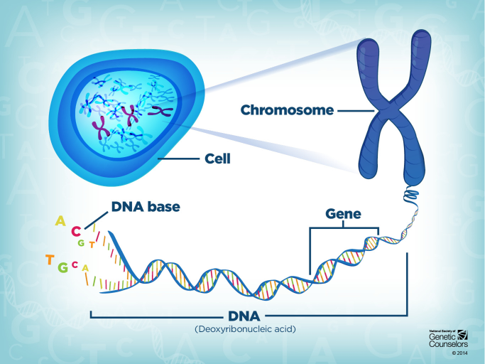

Slide 9
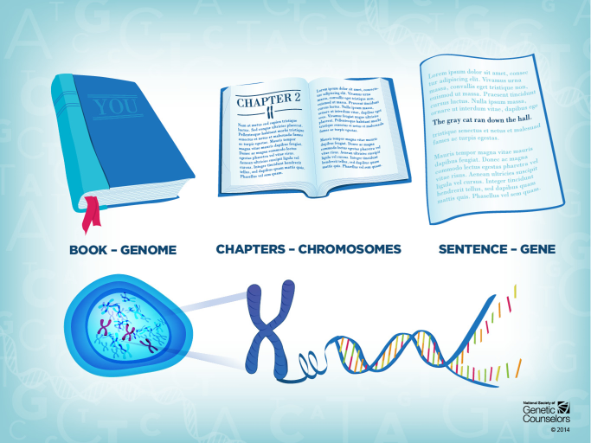
24%
58%

Slide 10
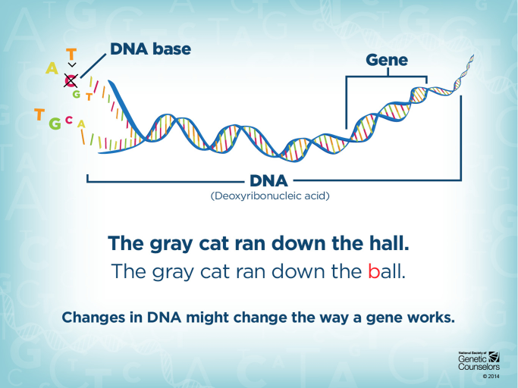

Slide 11
Inheritance
Autosomal Dominant
50% risk for EACH offspring
Same risk for males and females
If a person does not have the mutation he or she can NOT pass it on
Caused by a specific mutation type known as EXPANSION

Slide 12
Myotonic Dystrophy Type 1
DMPK gene
CTG Repeats (> 50 is affected)
Anticipation
Congenital Myotonic Dystrophy

Slide 13
Myotonic Dystrophy Type 2
CNBP gene
CCTG repeat (>75 affected)
No Congenital type

Slide 14
Genetic Testing
Diagnostic Testing
Predictive Testing
Reproductive Testing

Slide 15
Diagnostic Genetic Testing
Genetic testing on an individual who has clinical signs of myotonic dystrophy

Slide 16
Predictive/Presymptomatic Genetic Testing
Genetic testing for someone with NO symptoms who has a family history of myotonic dystrophy genetically confirmed

Slide 17
Reproductive Genetic Testing
Prenatal testing
- Genetic testing on pregnancy
Preimplantation Testing
- Test embryo to determine gene status embryo prior to uterine transfer

Slide 18
Family Planning
Planning if, how and when to have children
Explore options for having children that modify the risk of passing it on
Personal decisions based on individuals beliefs, desires and conditions

Slide 19
Considerations
Personal Gene status/knowledge of gene status
Desire for biological children (or not)
Costs of various options
Physical and emotional preparedness

Slide 20
Decisions Decisions Decisions
Adoption Conception with no testing
Prenatal testing PGD/IVF
Egg/sperm/embryo donation No Children
Issue of a parent with Myotonic Dystrophy remains

Slide 21
Genetic Counseling for Family Planning
Explore thoughts, feelings, values
Explore partner disagreements/agreements
Encourage open communication
Discuss when to start family
Discuss experience of myotonic dystrophy for that individual and other caregiver responsibilities
Educate about options and weigh pros and cons of each

Slide 22
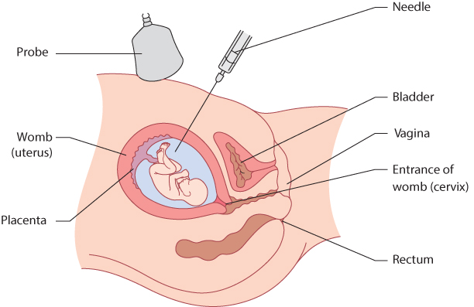
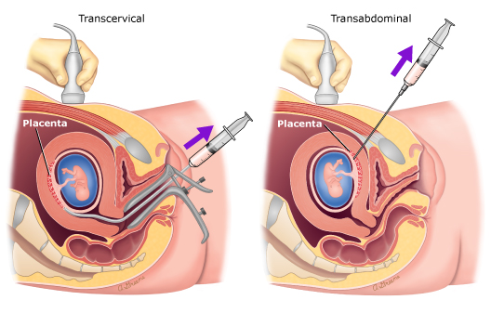
Prenatal testing
Amniocentesis
Chorionic Villus Sampling (CVS)
Performed at 15+ weeks of gestation
Low risk of complications about 1/400 risk for miscarriage
11-13 weeks of gestation
Slightly higher risk for miscarriage
Small chance of needing an amnio for confirmation/clarification

Slide 23
PGD
(Preimplantation Genetic Diagnosis)
This has to be in conjunction with IVF (In vitro fertilization)
This is diagnostic testing done on an embryo at a 6-8 cell stage
Only those embryos without the myotonic dystrophy gene expansion are transferred to the uterus

Slide 24
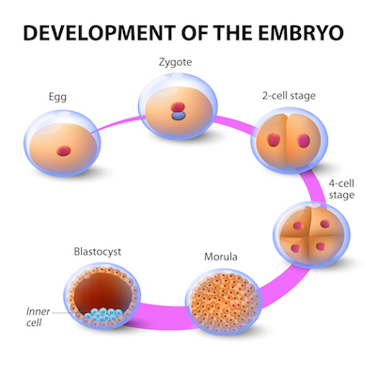

Slide 25
The General Method of IVF
Monitor egg maturation in the ovary
    Ultrasound
    Hormone levels
Collect eggs (mother’s own or from donor)
    - Injection of human chorionic gonadotropin (hCG) and follicle stimulating hormone (FSH) to time egg ripening
    - Transvaginal aspiration using hollow needle

Slide 26
The General Method of IVF
3. Nurture embryo growth by incubating in medium containing various nutrients and hormones
- If not doing PDG, incubate until embryo is 5-6 days old (blastocyst)
4. Transfer embryos (usually 3-6) to uterus, artificially removing zona pellucida if necessary (“hatching”)

Slide 27
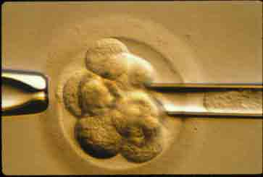
Blastomere Removal for PGD
Remove one cell after 2-3 days (6-8cell stage) for testing

Slide 28
Pregnancy Success Rates
Varies between clinics and couples
Most publish their pregnancy rates- what couples really care about is birth rate
Birthrates are relatively similar to natural pregnancies: 20-30%

Slide 29
IVF/PGD Considerations
Long and expensive process
Hormone injections, multiple procedures, time
IVF usually not covered by insurance because couples are considered fertile
  Varies by insurance company
  May be able to get some reimbursement
  Massachusetts and Illinois- covered
  Costs vary but on average $25,000
PGD may get covered
  Costs about $3,000
0.5% risk for misdiagnosis- recommend Prenatal testing as well

Slide 30
FAMILY STORIES

Slide 31
No Perfect Answer/No Uniform Answer
Be flexible with yourself and your partner
We change over time
No guarantee for a “healthy” baby ever
These methods ensure no myotonic dystrophy in offspring but cannot rule out every possible genetic or health condition
Each individual, couple, family will make the best decision for them at that point in time with information available to them at that specific point in time.

Slide 32
Things To Consider
These are complex issues
You are not alone
Seek out a professional - Genetic counselors are available to help navigate this complex process
National Society of Genetic Counselors
Seek out support from others facing the same issue; MDF support group or Facebook group are options

Slide 33
Thank you!

