Slide 1
Managing progression over time
Gagnon, Cynthia, OT PhD GRIMN and Raymond Kateri, doctoral student and GRIMN
Notes:
2018 MDF Annual Conference Panel Discussion Questions
Rev. 07-26-2018 (Charles Thornton, Leah, Molly)
Question 1: Describe a time when your disease took a turn for the worse. [we are interested in life events, medical events, or anything they have experienced that has led to changes in disease]
Question 2: Discuss triggers that you have experienced that have generated changes in the disease, such as stressful event or situation, flu or other illness, new or changes medications, pregnancy, surgery etc.]
Question 3: In your experience of managing the disease changes over time, what has worked and what hasn’t?
Question 4: How would a clinically meaningful therapy affect the progression of your symptoms?

Slide 2
Key messages about progression
Yes I use it
and I love it
And I help the economy

Slide 3
Participation restrictions
21 à 64% will experienced restriction in their participation¹
Human help
Most affected domains
Housing
Mobility
Work
Leisure
Change with time but most will remain fairly functionnal to some levels
¹ Gagnon et al., 2007 ; ² Raymond et al. (submitted)

Slide 4
Progression over time (previous studies)
Change in in participation over time
slowly more difficult to perform activities
Nutrition and personal care ^{1,2}
Housing ^{1,2}
Mobility ²
Leisure ²
All members of the family will tend to change their routine³
Giving up some activities ⁴
Partly participating ⁵
¹ Nätterlund et al., 2000 ; ² Boström et al. 2005 ; ³ Geirdal et al., 2015 ; ⁴ Cup et al., 2011 ;
⁵ LaDonna et Venance, 2015

Slide 5
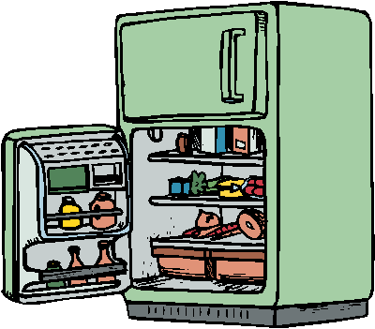
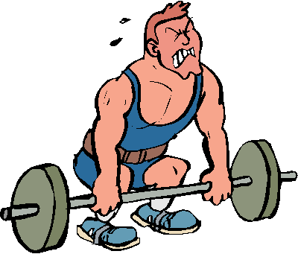
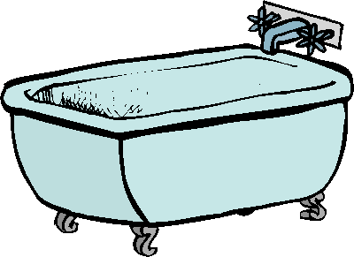
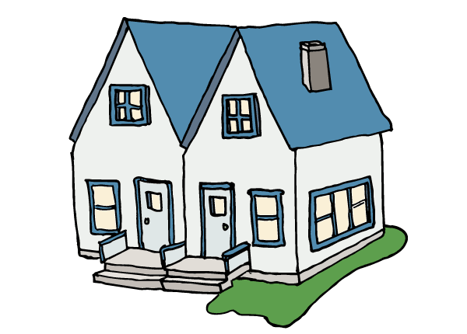
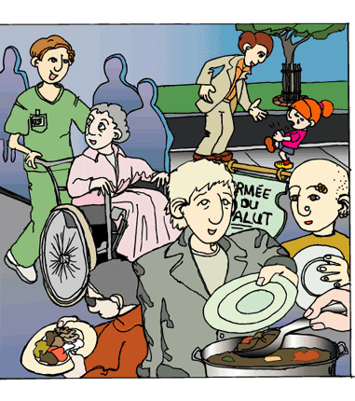
A quick portrait over 9 years
Nutrition 4,4 % 33,6 %
Personal condition 12,2 % 54,8 %
Personal care 4,3 % 37,4 %
Housing 28,7 % 31,3 %
Mobility 22,6 % 43,5 %
Community life 10,4 % 35,7 %
Leisure 14,4 % 52,3 %
¹ Raymond et al. (submitted)

Slide 6
Trajectory is different for everyone
You got power over the trajectory of your disease and your life !!!

Slide 7
Ongoing study to understand how people adapt over time
The perspectives of the patient, significant other and healthcare professionals and what statistic can tell you

Slide 8
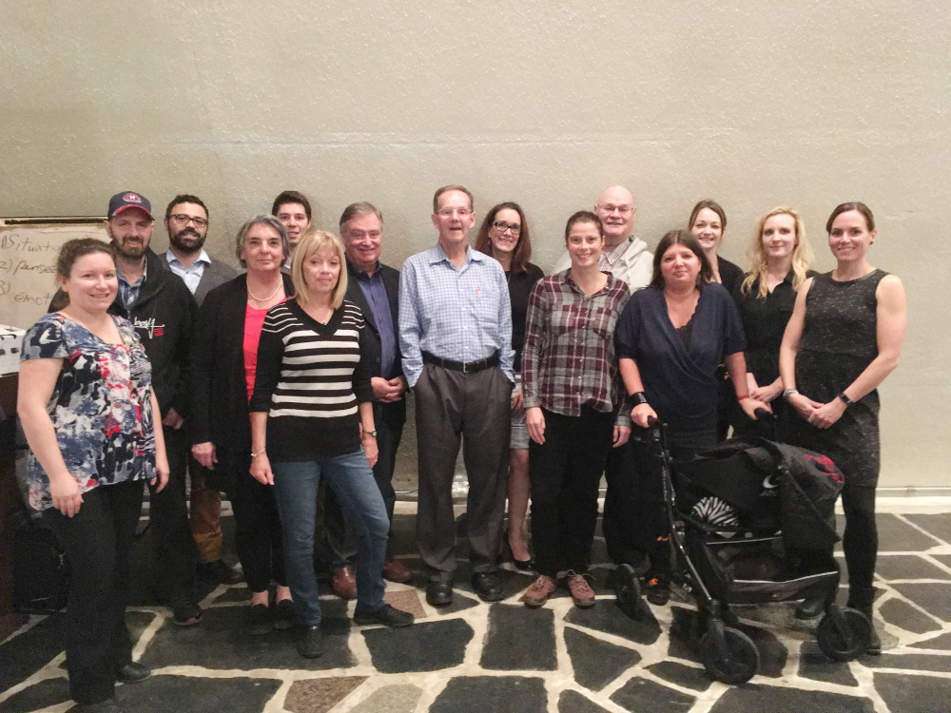
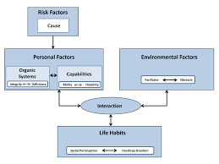
What we can do to make thing better

Slide 9
Management of symptoms/impairments
Some key factors

Slide 10
Muscle Strength
Key factors explaining your current participation level and how it will progress
Things you can do to help
Formal assessment by your rehabilitation team
Learn to see technical aids as a way to make thing easier
« Several of our patients as fought over for years not to use a walker or a wheelchair but once they accepted them, they realised what they have missed in term of autonomy ”
Keep active !!! (stay tuned for more next year)
Nutrition is a key building block (muscle needs protein)

Slide 11
Fatigue
Key factors explaining your current participation level and how it will progress
No it is not usual fatigue that everyone experienced !!!
Things you can do to help
Formal assessment by your medical team
Energy management (on-line course avaible)
Choose what you will keep (most meaningful activities)
Adapt your activities and be inventive
Energy of all your family; planned together
Medication may help
Nutrition is a necessary key building block

Slide 12
Hypersomnolence
Key factors explaining your current participation level and how it will progress
No it is not something in your head
Things you can do to help
Formal assessment by your medical team
Medication may help
It may progress or happen overtime
Nutrition is a necessary key building block

Slide 13
Organizing your life differently
Yes I use it and I love it

Slide 14
Nutrition issues
Ability to prepare meal and eat will decrease over time
Nutrition is a key issue as disease progress and you are getting older
Modify your role during meal preparation
Geat delivery solutions
I use it, I love it and I am helping
the economy

Slide 15
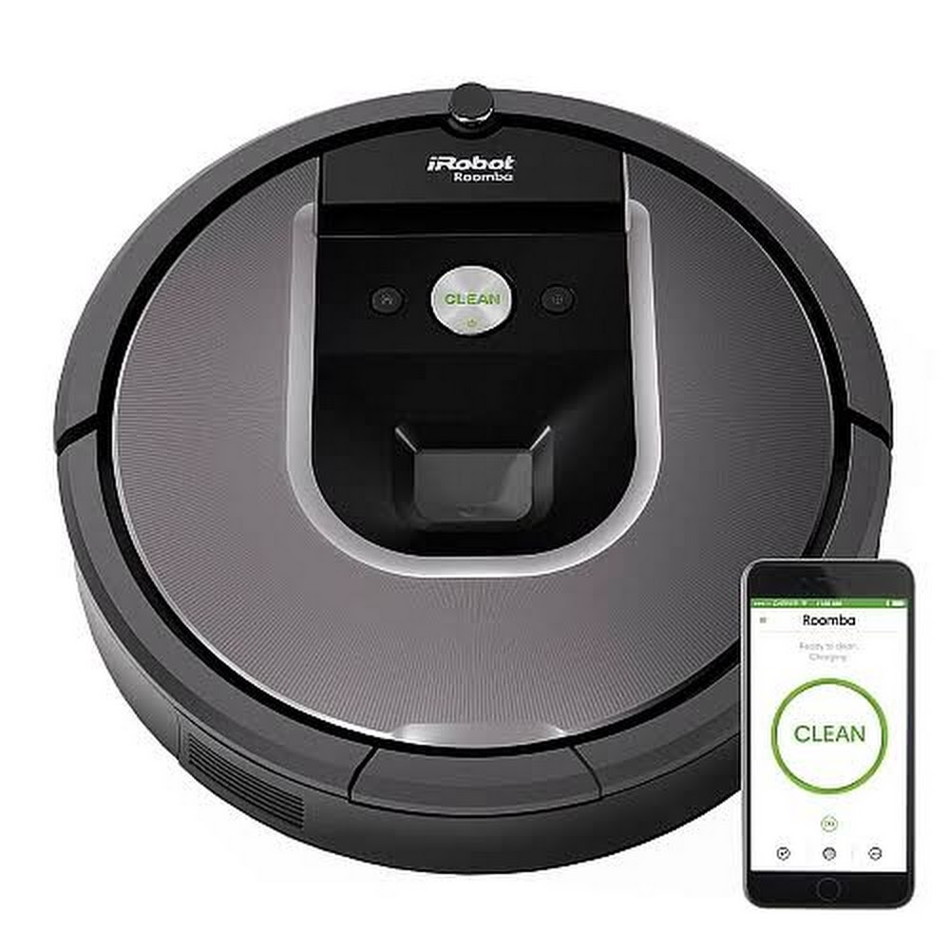
Housing issues
« Yes someone help me clean my house » … and
I love it !!!!!
A key factor to a better participation 9 years later
Ps Your working on your disease !!!! and help the economy !!!
Energy conservation
Reogarnized your shelves/get stuff out !!!
Plan for the future …
Moving to a new house/appartment
1st floor/master bedroom/bathroom
Easy acces to the house
Bathroom
See my previous presentations at the digital library on MDF website

Slide 16
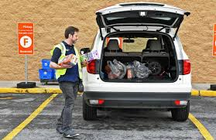
Walking issues
Keep fit !!! Even more important than ever
Muscle mass
Respiratory functions/highly related to endurance
Physiotherapy regular follow-up
Walking aids
Risk of fall
Environmental barriers (OT)
Walking vs Energy conservation
Better planning of community outings
Several shops delivers and shop for you
Yes I use it and I love it

Slide 17
Community activities
Something I knew for so long!!! Please identify it as a research priority !!!!
Digestive symptoms
Obstacles in the environment
Walking capacities
Help yourself with technical aids and mobility aids

Slide 18
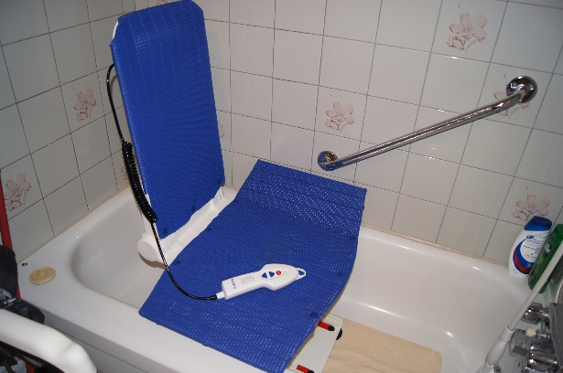
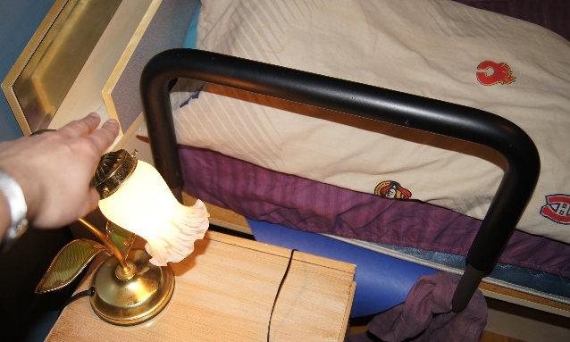
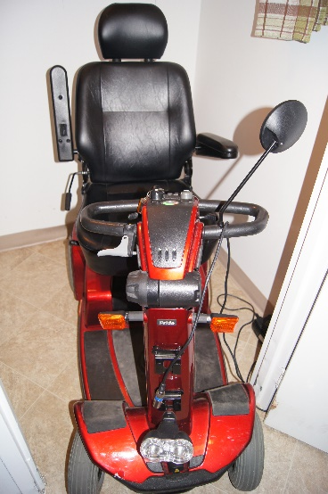
Patient’s and carers perspectives
Facilitators
Disease acceptance (patients and family
Get help does not happen overnight
May be variable with time
Use of technical aids
Long-term management with the same medical team

Slide 19
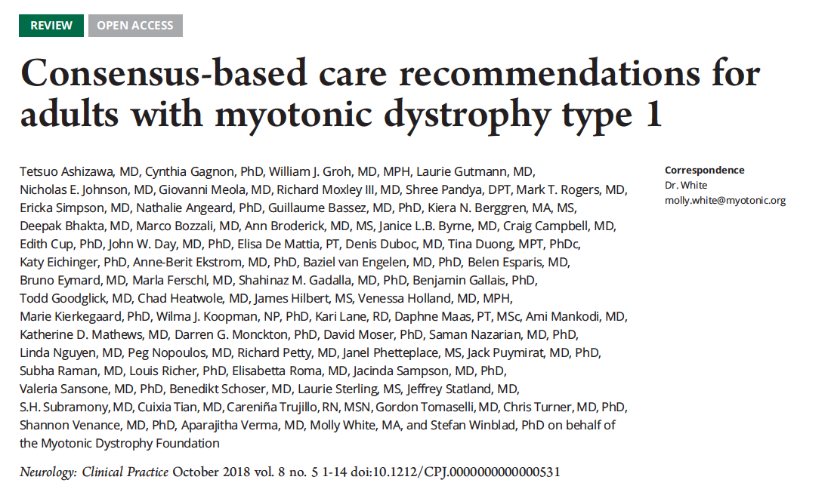
Getting expert of your disease
Get your medical and rehabilitation teams to gain expertise in your disease
Hospitalization and decrease general health is a key factor

Slide 20
Patient’s and carers perspectives
Facilitators
Physical help from the family
Motivation and psychological support from family and friends
Services proximity
Planning this if you are moving

Slide 21
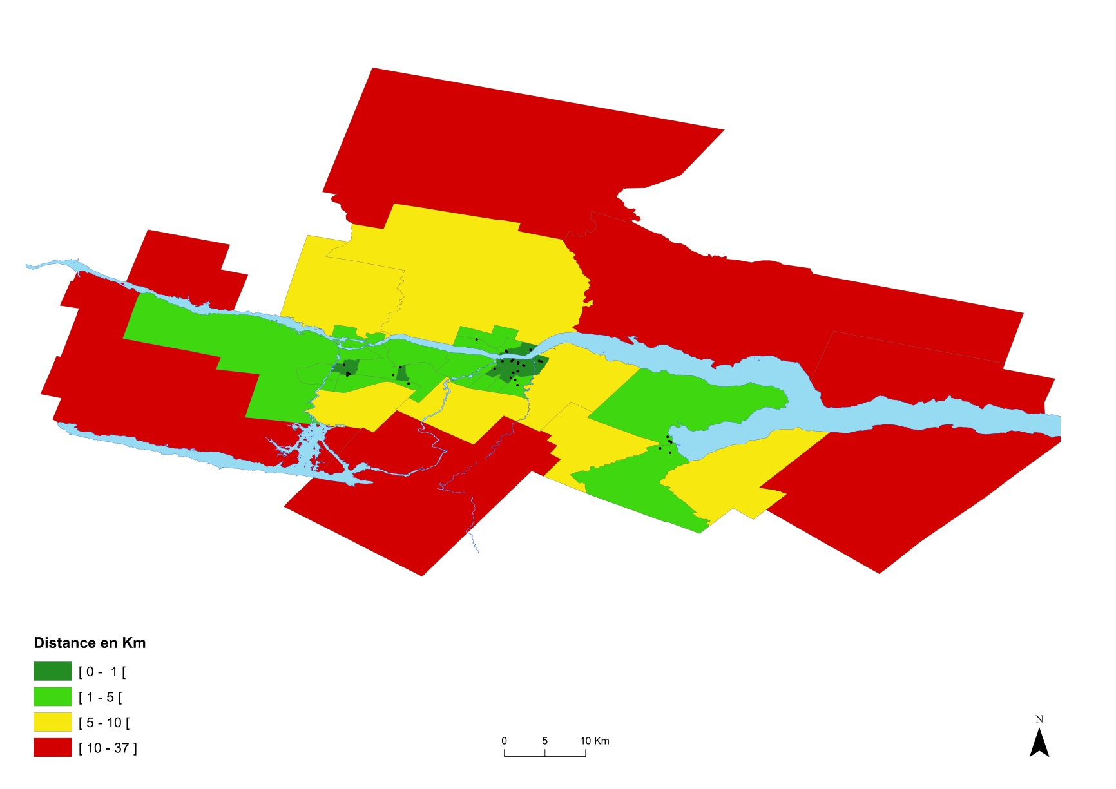
Mean distance to a GP
Notes:
Permettait d’analyser la question d’accès en tenant compte de la contiguïté et de l’interdépendance entre les quartiers

Slide 22
How far our patients are from key services
 | Distance
Services | < 1km (%) | 1 - 4 ,9 km (%) | 5-9,9 km (%) | 10 km et + (%) | Moy | Lien avec le phénotype
NMD clinic | 42,3 | 34,1 | 9,7 | 13,9 | 5,2 km | n.s.
GP | 32,6 | 39,7 | 9,4 | 18,4 | 3,5 km | n.s.
Pharmacy | 48,7 | 26,6 | 10,9 | 13,9 | 3,6 km | p < 0,05
Grocery stores | 36,0 | 49,4 | 7,9 | 6,7 | 2,9 km | n.s.
Small grocery shops | 15,7 | 60,3 | 10,1 | 13,9 | 4,0 km | n.s.
Environment rich in services within close distances
Notes:
Sur les 267 patients répertoriés, il y en a 80 atteints de DM légère, 124 atteints de DM adulte, 52 de DM infantile et 11 de DM congénitale. Il s’agit du phénotype des patients.
Le phénotype n’est pas associé à la défavorisation du milieu de résidence ni à sa densité résidentielle. Il n’est pas associé non plus à l’âge ni au sexe.
La distance aux services n’est pas liée au sexe ni à l’âge. Elle n’est pas non plus associée au phénotype pour la plupart des services et varie beaucoup au sein d’un même groupe. Les patients atteints de DM adulte se localisent toutefois en moyenne plus près des services postaux, financiers et des pharmacies que ceux atteints de DM infantile.
Le rural est plus éloigné de tous les services que l’urbain résidentiel ou dense (sauf pour les dépanneurs). L’urbain dense est plus près de la plupart des services comparativement à l’urbain résidentiel, sauf pour les CPE, les épiceries de quartier, les médecins et la santé spécialisée.
Conclusion du constat 3 : Ceci fait en sorte que la prise en charge des patients est plus complexe

Slide 23
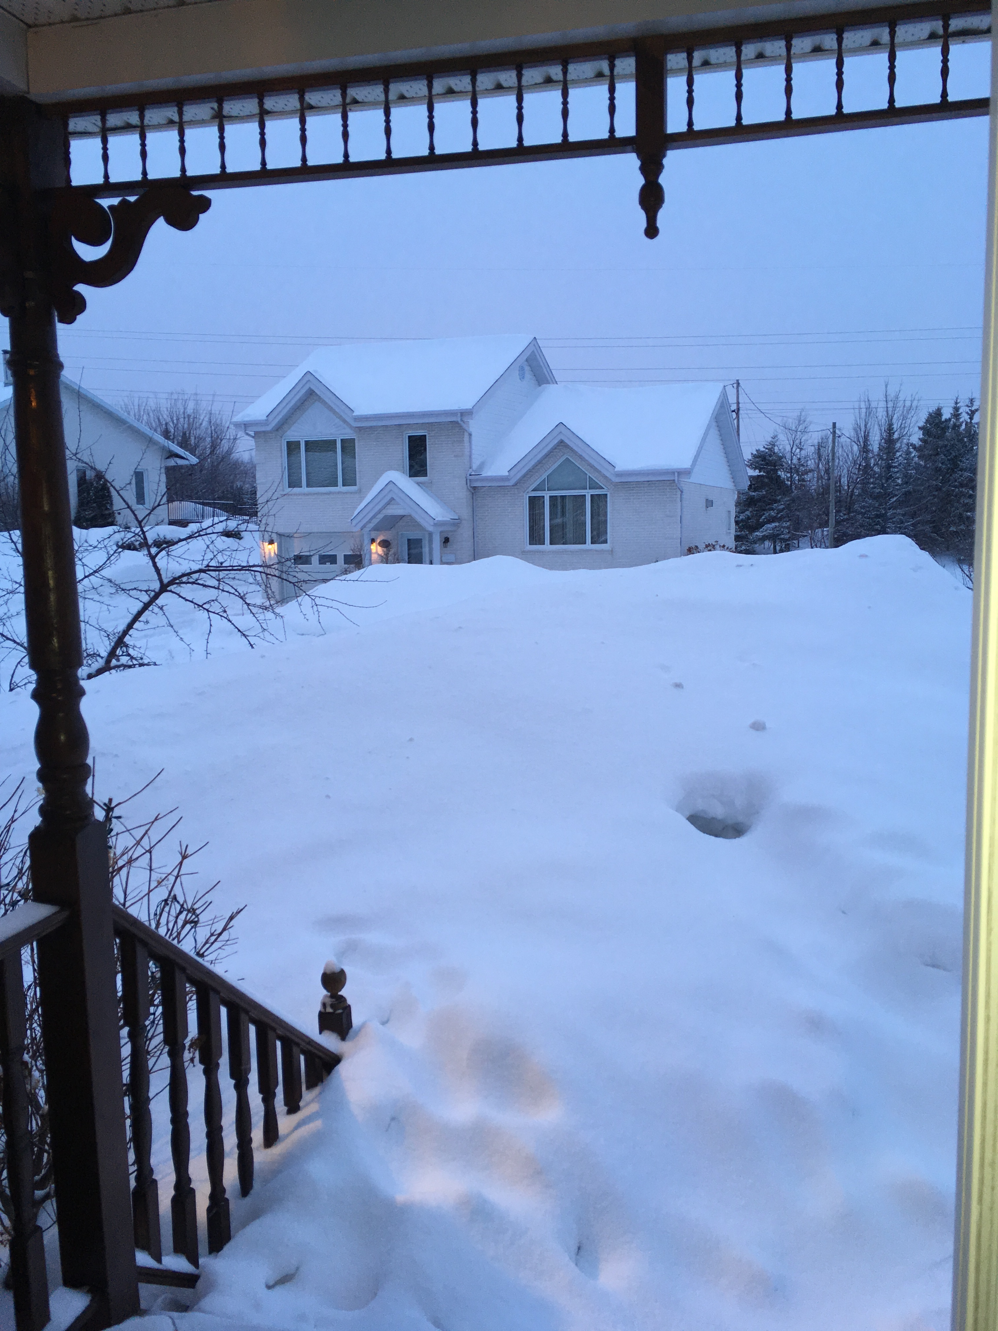
Patient’s and carers perspectives
Barriers
Snow (Saguenay specific !!! )
Fear of falling
Discuss that with your PT and find solutions
Stigmatisation
Lost of the driving permit
Learn how to use the community transport
Apathy (cognitive behavioral therapy)
Lack of support from family

Slide 24
Keeping up with progression
I use and I love it
Being assertive !
Practice what to say when hearing unwanted advice, criticism or insensitive comments: “Thank you for your concern”; “I’ll keep that in mind”; “I appreciate that you care. We’ve decided that this is the best way to handle the situation.”
MDA https://www.mda.org/sites/default/files/publications/Learning_to_Live_P-195.pdf

Slide 25
Questions

