Slide 1
Myotonic Dystrophy and Sleep
Myotonic Annual Conference
Philadelphia
September 14, 2019
John W. Day, MD, PhD
Professor, Neurology, Pediatrics, Pathology Director, Division of Neuromuscular Medicine
Stanford University
Notes:
1)We’ve studied more than 300 genetically affected individuals from more than 100 families.
2) We studied all available individuals ages 18-80 years who had the CCTG expansion.
3)Most testing was done in the field, and not all tests were performed on all individuals.

Slide 2
Disclosures
In addition to funding from NIH/NINDS, MDA, SMAFoundation, MDFoundation, in the past 12 months I have had the following financial relationships :
Audentes, Inc. – consultation
AveXis – research grant and consultant
Biogen – research grants and consultant
Cytokinetics – research grant and consultant
Expansion Therapeutics – research grant
Genentech/Roche – research grants and consultant
Genzyme/Sanofi – research grant
Ionis Pharmaceuticals – research grant
PTC Therapeutics – research grant
Santhera Pharmaceuticals – consultation
Sarepta Therapeutics – research grants and consultant
Scholar Rock – research grants
Athena Diagnostics Royalties for DM2 and SCA5 genetic testing

Slide 3
DM Research at Stanford
Sleep and CNS evaluations in myotonic dystrophy
DMCRN
Specimen Repository
DM outcome measures and biomarkers: neuropsychology, MRI, Electrophysiology, CSF, blood

Slide 4
Conclusions
Myotonic Dystrophy (DM) affects many body systems that directly or indirectly alter sleep
Altered throat and breathing muscles reduce sleep quality
Brain sleep centers alter sleep patterns and quality of sleep
REM sleep abnormalities
Abnormal sleep in DM affects behavior, cognition and quality of life
Treatments can improve sleep quality in DM
Research is shedding light on DM sleep including CNS causes and effects

Slide 5
Organization of Talk
Global effects of DM and how they impact sleep
Specifics of sleep abnormalities in DM
Ongoing DM Sleep Research
Questions (and Answers?)

Slide 6
First – Questions for the audience
For individuals with DM (directly or family report)
How many, at some time, have been told to use breathing support at night (e.g., CPAP, BiPAP, AVAPS, Curiass)
How many actually ever tried it?
How many continue(d) to use it?
How many have been prescribed a stimulant to combat daytime sleepiness (Provigil/Nuvigil/modafinil; Ritalin/dexedrine; Cylert/pemoline)?
How many have ever tried it?
How many continue to use it?

Slide 7
Second – More Questions for the audience!
Has anyone ever been confused as to whether they have been dreaming or awake?
Does anyone report having frequent very vivid dreams?
Has anyone ever found it really hard to move right when waking up?
Has anyone ever noticed that they collapsed when suddenly afraid, startled, or abruptly laughing?

Slide 8
Third – Even More!
Has anyone fallen out of bed while asleep, or woken up in a different room?
Does anyone know if they often move or thrash around a lot while asleep?
Does anyone have trouble getting to bed at the same time each night?
Does anyone have difficulty falling asleep?

Slide 9
DM Clinical Features
Pathological Mechanism
Localization
Skeletal Muscle
Brain
Heart
Eye
Endocrine
Gut
Skin
Blood
Developmental
Degenerative
Physiologic
Hormonal
Cardiovascular
Metabolic
Neoplastic
Inflammatory
Proximal Cause
DM Genetic Change

Slide 10
DM Alteration of Sleep
DM Dysfunctions That Affect Sleep & Stamina
Affected DM Systems That Alter Sleep
Breathing Strength
Airway Obstruction
Sleep Quality
Sleep Length
Sleep Cycle
Muscle Fatigue
Mental Fatigue
Metabolic
Skeletal Muscle
Brain
Heart
Endocrine
Gut
Proximal Cause
DM Genetic Change

Slide 11
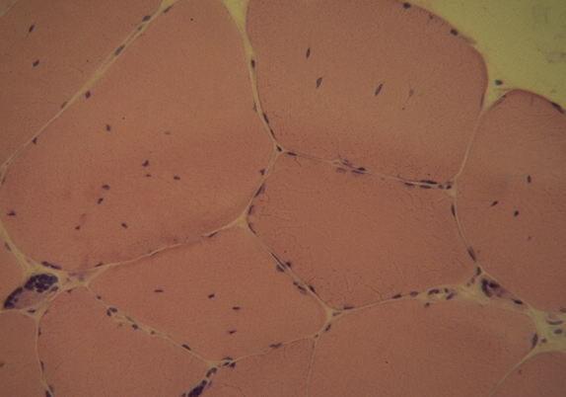
RNA Changes Precede Pathology
Muscle Bx @ 28y/o
Muscle Bx @ 36y/o
Savkur, et. al. AJHG, 74:1309; 2004
Notes:
Normal muscle preferentially expresses an insulin-sensitive form of the IR. In DM1Cooper has shown that the IR RNA is abnormally spliced, leading to preferential expression of the insulin-insensitive isoform. We now show that the same abnormal splice form occurs in DM2.

Slide 12
How is ClC-1 altered in DM?
Alternate Splicing
mRNA
Charlet-B, et. al., Mol Cell, 10:45, 2002
ClC-1 Immunofluoresence
Mankodi, et. al., Mol Cell, 10:35; 2002
Normal
DM1
DM2

Slide 13
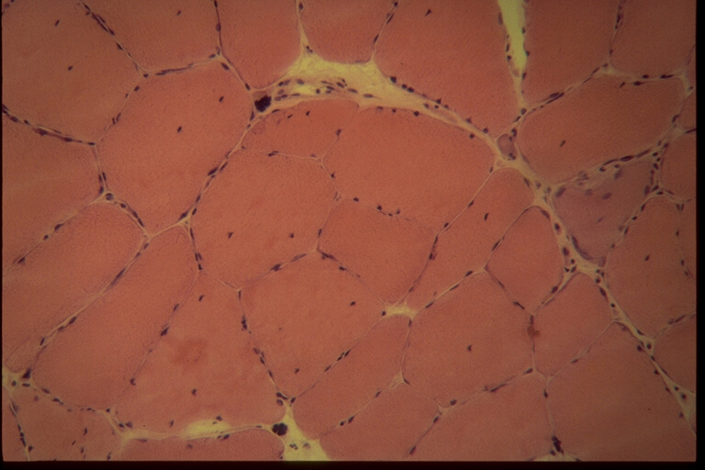
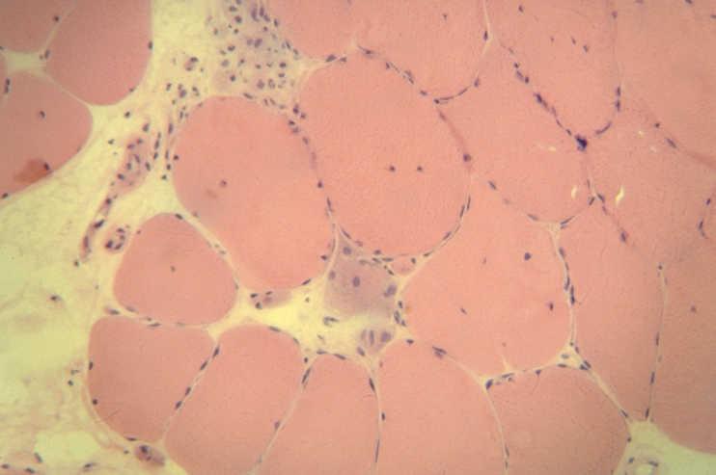
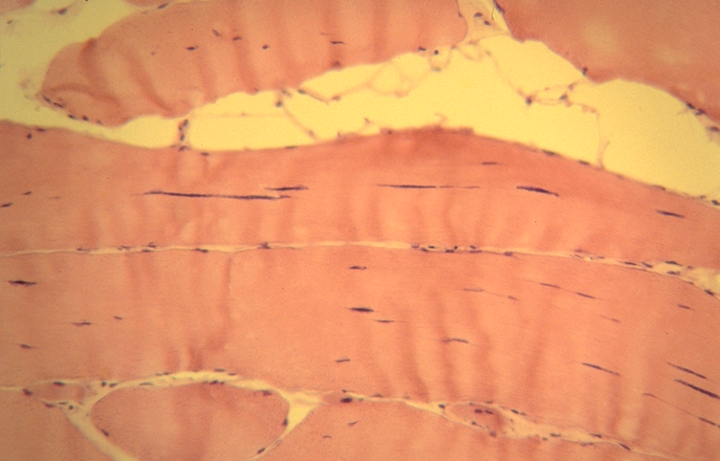
DM muscle pathology – congenital myopathy – muscular dystrophy – metabolic myopathy – myotonia
Notes:
The histologic features parallel those of DM1, with marked variation in fiber size, degenerating and necrotic fibers, a profusion of centrally located nuclei, and frequent severely atrophic “nuclear bag” fibers.
In addtion, longitudinal sections can show the central nuclear chains characteristic of DM1.

Slide 14
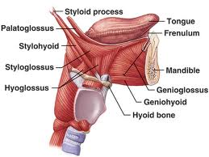
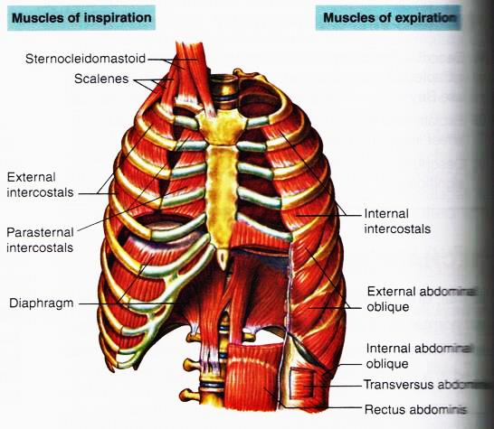
DM Muscle Involvement Directly Affecting Sleep
Notes:
The histologic features parallel those of DM1, with marked variation in fiber size, degenerating and necrotic fibers, a profusion of centrally located nuclei, and frequent severely atrophic “nuclear bag” fibers.
In addtion, longitudinal sections can show the central nuclear chains characteristic of DM1.

Slide 15
Typical Stages of Sleep

Slide 16
Daytime Changes and Typical Sleep-Wake Cycle

Slide 17
DM Changes Breathing in Sleep
Narrow throat – increased snoring
Weak throat muscles – increased snoring
Weak breathing muscle – sleep disruption
Central control of breathing altered
Central control of wakefulness altered
Central control of sleep cycles altered
Central biological clock altered

Slide 18
How DM patients experience sleep?
Greater than normal need for sleep
Inability to awaken quickly
Snoring, dry eyes, dry mouth during sleep
Fragmented sleep patterns
Excess or abnormal sleep movements
Sleep paralysis or sleep-related hallucinations or excessively vivid dreams
Self-medication or prescriptions to wake-up or fall asleep
Unusual sleep patterns and insomnia
Notes:
The histologic features parallel those of DM1, with marked variation in fiber size, degenerating and necrotic fibers, a profusion of centrally located nuclei, and frequent severely atrophic “nuclear bag” fibers.
In addtion, longitudinal sections can show the central nuclear chains characteristic of DM1.

Slide 19
Treatment of DM Daytime Sleepiness
Treat sleep-related breathing changes
Evaluate any sleep abnormalities with a sleep specialist
Consider treatment with stimulant medication
Stay aware of new sleep treatments
Expansion Therapeutics – in DM trial
Harmony – approved, investigating DM
Jazz Pharmaceuticals - approved, considering DM
Definitive / genetic treatments in development

Slide 20
Conclusions
Myotonic Dystrophy (DM) affects many body systems that directly or indirectly alter sleep
Altered throat and breathing musculature can reduce sleep quality
Direct effects on brain sleep centers can alter sleep patterns and quality of sleep
Abnormal sleep in DM affects behavior, cognition, quality of life, and overall health (heart, energy, etc.)
To treat sleep abnormalities in DM
Provide comprehensive baseline care
Thoroughly evaluate to understand cause of sleep disorder

