Slide 1

2019 Myotonic Annual Conference
September 13-14, 2019
Philadelphia, PA

Slide 2
Emotional Wellness and Empowerment in DM
Missy Dixon, PhD, MS
Department of Pediatrics

Slide 3
Disclosures
I have no relevant financial disclosures.

Slide 4

Objectives
Multiplicity of DM
BioPsychoSocial Approach
DM Experience
Strategies to promote emotional wellness and empowerment

Slide 5

The Multiplicity of DM
Stakeholders
CDM, DM1, DM2
Symptoms
Impact on function
Symptom management
Changes
DM Experiences

Slide 6

Stakeholders
Cognitive
Partner/Spouse
Child
Parents
Siblings
Other family
Caregivers
Friends
Co-workers
Medical team
Neighbors
Schoolmates

Slide 7
DM Type
CDM
DM1
DM2
Age spectrum across types
Disease duration varies

Slide 8
Symptoms
Physical
  alertness
  brain structure
  blood pressure
  cardiac
  GI
  muscle
  myotonia
  ocular
  pain
  physical appearance
  respiratory
  sleep
Cognitive
  attention
  concentration
  developmental delay
  executive function
  learning
  memory
  processing
  thoughts/perception

Slide 9
Symptoms
Psychological
  anxiety
  apathy
  ADHD
  autistic features
  communication
  depression
  pain
  personality
Social
  communication
  engagement
  identity
  opportunities
  school
  relationships

Slide 10
Impact on Function
Cognitive changes
Physical changes
Psychological changes
Social changes
Functional changes can influence one another
Cumulative effects with age

Slide 11
DM affects more than physical function
30-50% of individuals with chronic illness are at-risk for developing psychosocial issues
  Mood lability and irritability
  Self-esteem and self-efficacy
  Social difficulties, isolation/withdrawal
  Family conflict and disruptive behaviors
Why is this important?
  Impacts affected individuals, families, and caregivers, relationships
  Comorbid neurobehavioral and neurodevelopmental disorders (e.g., ADHD, autism, LD)
  Physical changes may contribute to psychological changes (cognition/emotional)
  Environment may contribute to changes in physical and psychological functioning
  Foster healthy social and emotional growth
    Positive coping skills and adaptive strategies
    Promotes resilience

Slide 12

DM Evolution
There are multiple changes occurring simultaneously and at different times at varying speeds throughout an individual’s disease course.

Slide 13
What is consistent in DM?
 | Congenital | Childhood DM | Adult DM
Consistent themes that appear in all DM cohorts: | cognitive changes emotional changes social changes physical changes | cognitive changes emotional changes social changes physical changes | cognitive changes emotional changes social changes physical changes
Disease duration

Slide 14
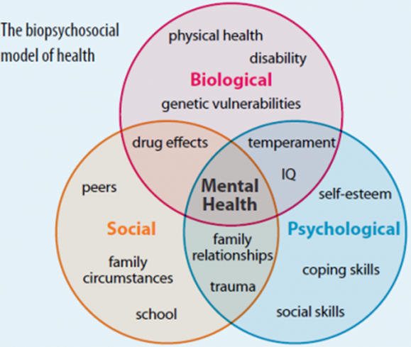
BioPsychoSocial Approach to DM
Biological
  Disease mechanism & severity
  Physical symptoms/limitations
  Health complications/ medical regimens
  Cognitive function & executive function (brain changes of structure and function)
Psychological
  Thoughts, emotions, behaviors (e.g. psychological distress, fear/avoidance beliefs, coping strategies, self-esteem and self-efficacy)
Social
  Environment (e.g., home, community, school)
  Relationships (e.g., family, peers)
  Cultural factors (e.g., work, family, economics)
(Eiser, 1985; Rae & O’Malley, 2016)
Notes:
BioPsychoSocial Approach used to understand the impact that these systems have on function.
Cognitive Function
Means and mechanisms of acquiring knowledge (i.e., reasoning, memory, perception, awareness, attention, judgment, and language)
Executive Function
Cognitive processes necessary for the cognitive control of behavior
Psychosocial Function
Psychological function of individual in the context of his/her social environment
Behavioral Function
Behavior in the context of social environment

Slide 15
Biological
What does this look like in every day life?
  Fatigue, sleep problems, incontinence, GI complaints, pain, headache, swallow, loss of function, decreased muscle power
  May contribute to anxiety, depression, apathy, attention, memory, daily functioning, executive function problems, behavior problems, interpersonal relationship difficulties, loss of social opportunities, limited access to social opportunity, changes perception of self (i.e., identity)

Slide 16
Promote Emotional Wellbeing and Empower
Communication
  Express concerns and feelings
    Avoid making assumptions- ask
    Cannot read minds
  Engage in active listening (HEAR what someone is telling you by being present)
  Talk first before taking action
  Make a plan to address changes ahead of time- Don’t operate in crisis mode.
  Non-verbal communication is equally important

Slide 17
Promote Emotional Wellbeing and Empower
Communication
  Start early/ It is never too late
  Establish good communication pattern
  Ask for feedback/ Be open to receiving
  Be direct- think/feel/want/need statements
  Do overs are okay
  Set expectations in the context of disease
    Does not provide a “hall pass” for bad behavior or getting out of activities
    Opportunities to strategize together and do it differently
  Practice: REPEAT REPEAT REPEAT

Slide 18
Promote Emotional Wellbeing and Empower
Adapt environment to disease progression
  Adapted environment contributes to feelings of success
  Increase social interactions
  Decrease apathy, depression, anxiety
Adaptive devices, power chairs, AFOs
  Sense of freedom and stability
  Increase confidence and social interactions
  Less fearful of falling

Slide 19
Psychological: Cognitive Symptoms
Mood
  Depression
  Anxiety
  Apathy
  Flat affect
Thinking and Concentration
  Linear, Circular, Disjointed
Attention Visual, Verbal
Language
Information Processing Speed
  Visual
  Verbal
Visual constructional
Visuospatial
Learning
Perseveration
Personality
Notes:
May have some, all, or none of these CF concerns: Thinking, Memory, Language, and Attention
Awareness of possible problem areas is important to rule out and address as necessary
Cognitive Functioning- means and mechanisms of acquiring knowledge (i.e., reasoning, memory, perception, awareness, attention, judgment, and language)
Executive Function- cognitive processes necessary for the cognitive control of behavior

Slide 20
Psychological: Cognitive Symptoms
Executive Function
  Working Memory
  Planning and Organization
  Monitoring
  Inhibition
  Shift
  Initiate
  Emotional Control
Memory: Visual, Verbal
Motivation
Problem Solving/Decision Making
  Too many choices
Notes:
Cognitive Function Concerns
Attention
Language
Memory
Thinking and Concentration
Executive Function
Automation, Planning, Organization,
Inhibition, Shift (resistance to change)
Emotional Control,
Initiate (getting started), Working Memory
Monitoring behavior/Time orientation

Slide 21
Cognitive Change
Gradual and subtle change
  Appear extreme to outsiders
What do symptoms look like at different stages of development and disease course
Symptoms can wax and wane
  Psychosocial
  Environment
Symptom commonalities/change unique to individual

Slide 22
What does this look like day to day?
EF/CF problems affect language, memory, attention and concentration
  Automation, planning, and learning
    Task completion
    Time orientation
    Initiative
    Resistance to change
    Switching tasks
    Behavior
    Mood

Slide 23
Important to know
Cognitive function issues are not one of physical function or motivation.
Individuals are not unwilling.
Unable to complete tasks and follow directions in the same way as others.
Rethink the way we approach giving tasks/asking for things.

Slide 24
Promote Emotional Wellbeing and Empower
Strategize to find ways that work for the individual
Memory: short sentences, clear instruction, divide information
Visual cues to help process information
Check-in: Does he understand?
Ask for information to be repeated to synthesize and build verbal memory
Summarize and repeat information
Introduce new information in steps

Slide 25
Promote Emotional Wellbeing and Empower
Extra time for instructions
Break tasks into smaller parts
Make lists and check off completed tasks (individuals can do)
Extra time for transitions
Help get things started
Create a system for organizing an planning
Use lists and calendars (agenda planning)
Create a system with check lists for self-monitoring
Reassess regularly
Repeat, Repeat, Repeat

Slide 26
Psychological: Emotional and Behavioral
Emotional and behavioral problems are normal to healthy socio-emotional development
Emotional reaction to disease progression is normal for affected individuals and family
  Stages of grief
    Denial
    Anger
    Bargaining
    Depression
    Acceptance

Slide 27
Promote Emotional Wellbeing and Empower
Why is it necessary to address emotions?
Children/adults recognize to consequences of DM Disease.
Psychosocial adjustment related to:
  Relationships w/ friends (⬇ w/ age and/or disease progression)
  Dependence, hostility, productivity (⬆⬇ w/ disease progression)
  Anxiety, depression, and withdrawal (⬆ w/age or disease progression)
Learned helplessness may develop and can lead to emotional reaction (apathy, depression) and/or behavioral problems (passivity, tantrums).
Emotional concerns
  Increase when symptoms increase; associated anxiety
  Increase when there is a loss of independence and/or control- response:
    hostility, depression, relief
  Increase when peers are moving on and individuals feel stuck because of their NM disease.

Slide 28

Promote Emotional Wellbeing and Empower
Caring/supportive relationships (primary factor)
  Team approach- healthcare, family, support network
Communication and problem solving
  Continuous open dialogue with teams about symptoms, progression, and impact
  Start conversation early (never too early or too late)
Make realistic plans and steps to carry them out
  Understand disease progression and symptoms
  Talk about symptoms before they come on
  Make an approach plan- preparedness vs. crisis mode
Address strong feelings and impulses
  Mourn the change/loss of function and move on (not linear process)
  Use/find humor as healthy coping
  Maintain perspective

Slide 29
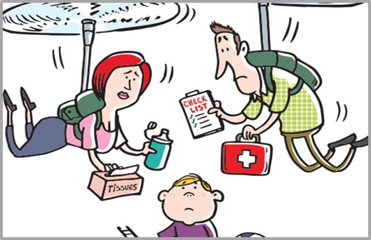
Promote Emotional Wellbeing and Empower
Family Factors
  Patient/child exists within a larger system
  Levels of family stress are related to patient’s adjustment to illness (Reid & Renwick, 2001)
  Issues include uncertainty about what to communicate, caregiver burden, anxiety, financial strain, and grief reactions.
    “Mutual pretense”
    Parental/Caregiver accommodation
    Others telling you how you feel

Slide 30
Myotonic Dystrophy

Slide 31
Promote Emotional Wellbeing and Empower
How do you frame your DM?
How do others frame your DM?
Do these frames compliment/conflict?
How does your/others frame contribute to daily life?
Notes:
Your DM experience/frame contributes to your identity- this may change as your disease progresses
Contributes to others’ identity also in the context of you. Their identity and feelings about themselves may change with disease progression
I have Myotonic Dystrophy, but I am more than my diagnosis!

Slide 32
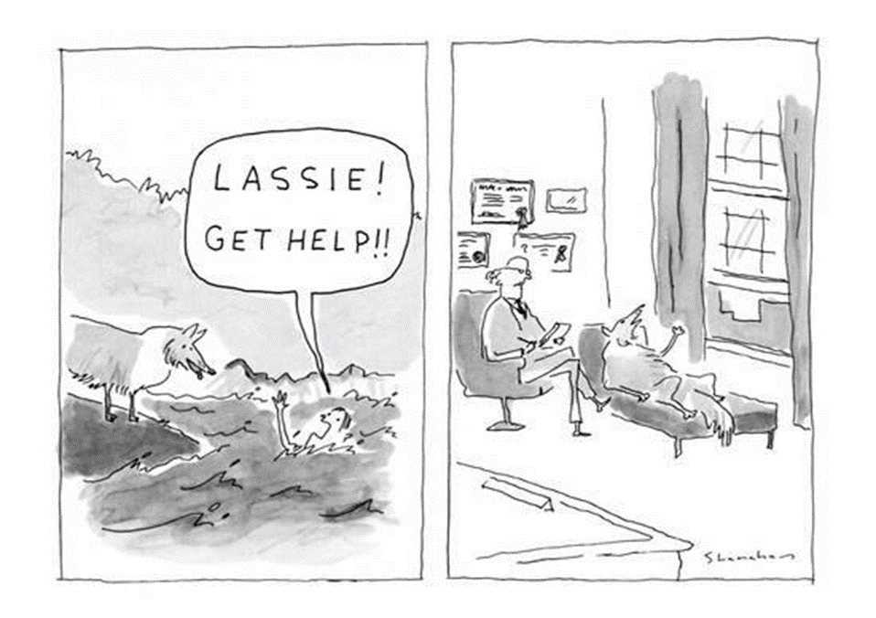
Promote Emotional Wellbeing and Empower

Slide 33
Promote Emotional Wellbeing and Empower
Psychological Model of Care
  Psychologist functions as part of multidisciplinary team
  Consults with neurologists and other medical, rehabilitation, and psychosocial providers
  Assesses emotional, behavioral, social, and adaptive functioning
  Proactive screening
  Brief, targeted intervention and referral
Notes:
DM is multisystemic disease. Behavioral health of patients and families important aspect of care and impacts quality of life.

Slide 34
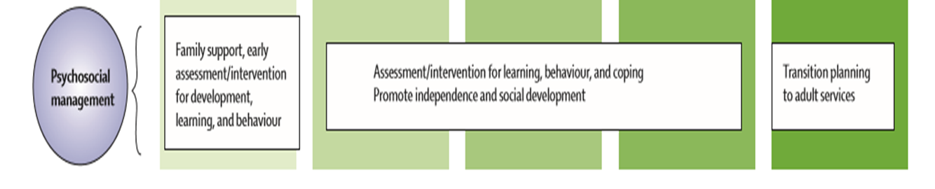
Promote Emotional Wellbeing and Empower
Psychological Care Considerations
  Emphasis on prevention and early intervention
  Transitions (e.g., to wheelchair) and declines in functioning tend to impact adjustment
  Developmentally sensitive approach

Slide 35
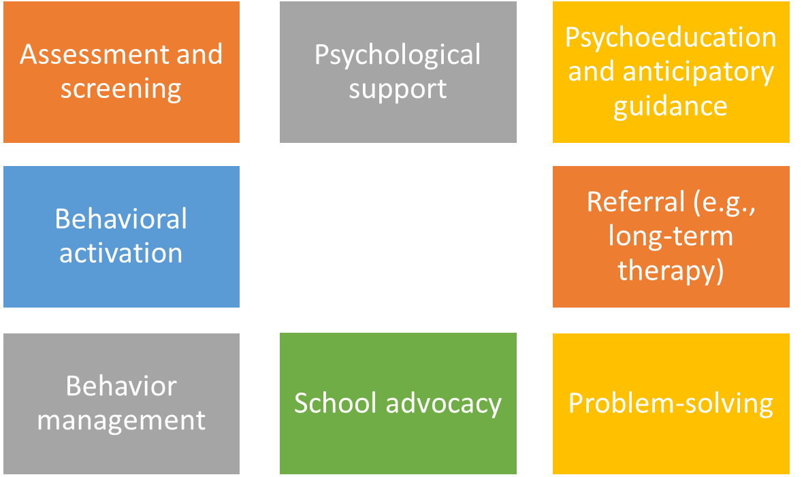


Promote Emotional Wellbeing and Empower
Intervention Components

Slide 36


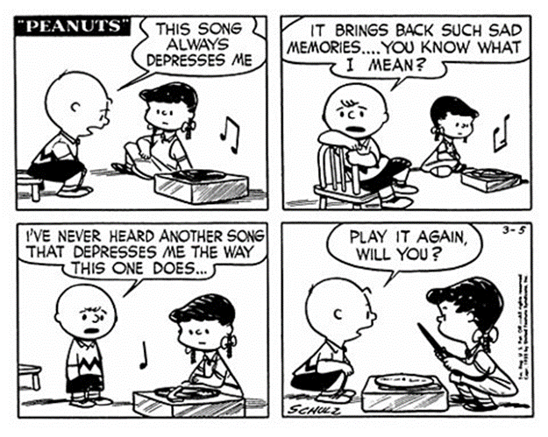

Promote Emotional Wellbeing and Empower
Behavioral Activation
  Emotional and behavioral problems decrease as social supports and involvement in activities increase
Need to interrupt the “downward spiral”

Slide 37
Final Thoughts
  Individuals DM can be at higher risk of experiencing psychological difficulties related to:
    Physical changes
    Changes in cognitive and executive function
    Emotional experience
    Interpersonal relationships
  Importance of integrating psychology
    Allows for preventative practices and early intervention
    Promotes resilience in affected individuals, families, caregivers
  Numerous factors are associated with emotional wellbeing
    Appropriate communication
    Fostering independence
    Increased social engagement
    Support systems

Slide 38
Thank You!
Missy Dixon, PhD, MS
Department of Pediatrics
missy.dixon@genetics.utah.edu

Slide 39
Thank you!

