Slide 1

2019 Myotonic Annual Conference
September 13-14, 2019
Philadelphia, PA

Slide 2
Myotonic Dystrophy 101
Lauren Elman, MD
Associate Professor of Neurology
Perelman School of Medicine, University of Pennsylvania

Slide 3
Epidemiology
DM1 is the most prevalent inherited neuromuscular disorder in adults
  13.5/100,000 live births in Western population
  1 in 3000-8000 worldwide
DM2 accounts for about 2% of myotonic dystrophy and is more common in Eastern European kindreds

Slide 4
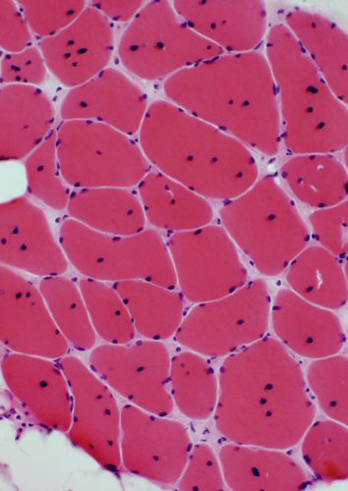
DM1 - Pathology
Internal nuclei
Fiber size variation
Notes:
These are nonspecific changes
Notice the lack of inflammation

Slide 5


Slide 6
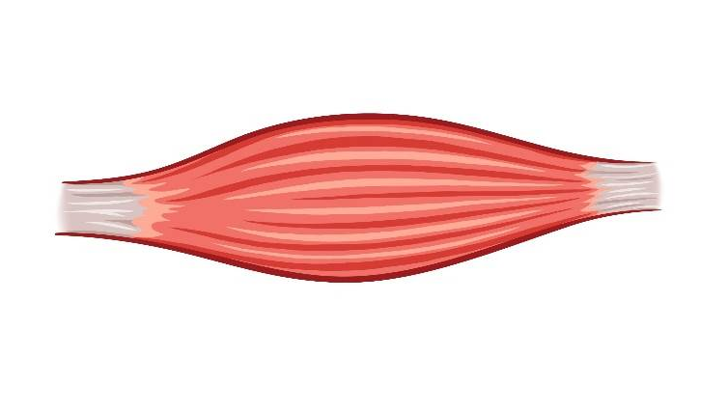
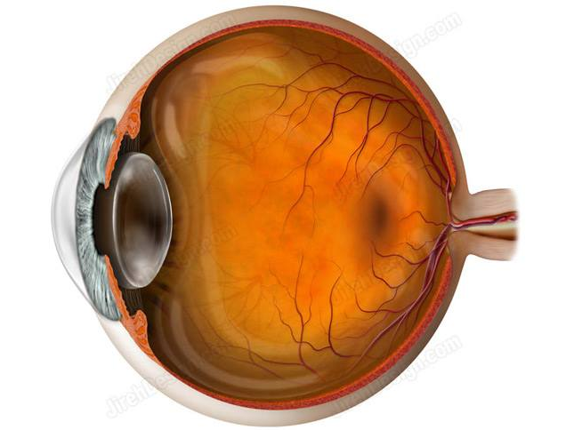
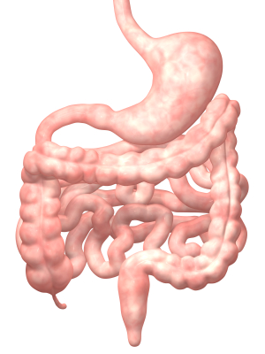

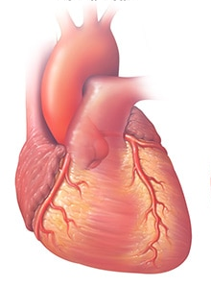
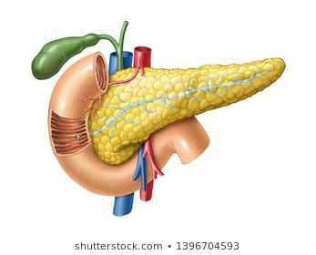
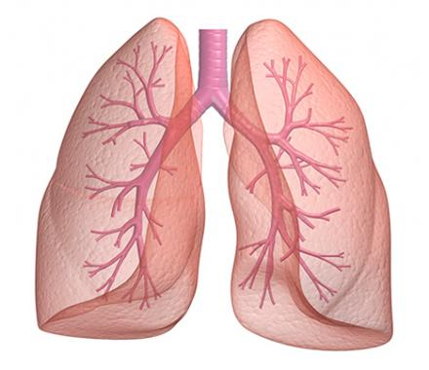
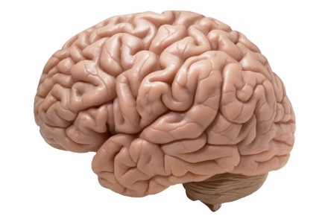
Myotonic
Dystrophy

Slide 7


Myotonic Dystrophy Type 1
Frontal
balding
Temporal
wasting
Ptosis
Masseter
atrophy
Long thin face
Tapered limbs
Notes:
Most prevalent inherited neuromuscular disease in adults
Incidence = 1/8000

Slide 8
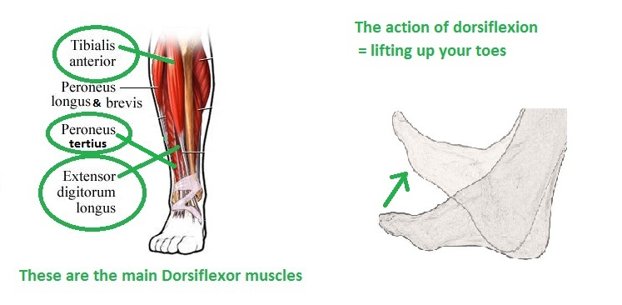
DM1 - Weakness
Early weakness is mild and distal

Slide 9
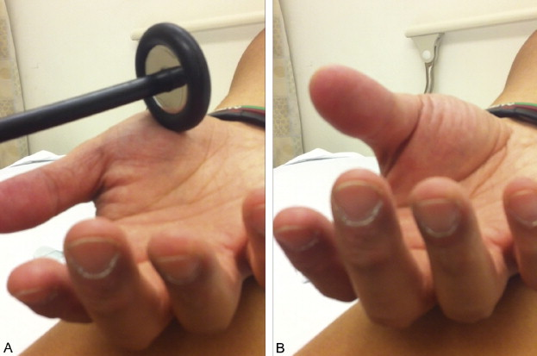
Myotonia

Slide 10
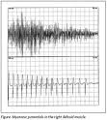
Myotonia
Slow relaxation of voluntary
muscle contraction
Abates with continued activity
This is a treatable symptom
Caused by reduced chloride
channels in sarcolemma (CLC 1)

Slide 11
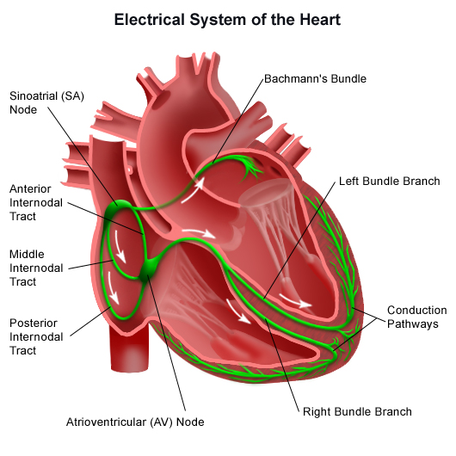
Cardiac Manifestations
Myocardial fibrosis may lead to destruction of the cardiac conduction system
Prolongation of PR interval and QRS duration
Arrhythmia

Slide 12
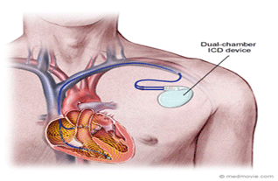
Cardiac Manifestations
Arrhythmias can include sinus bradycardia, heart block, atrial tachycardias, atrial flutter, atrial fibrillation, ventricular tachycardia, ventricular fibrillation

Slide 13
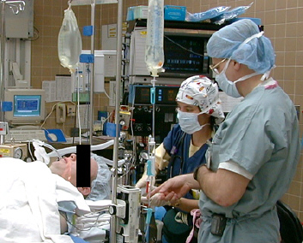
Anesthesia Considerations
Induction with depolarizing relaxants (succinylcholine) and reversal (neostigmine) may worsen myotonia (no clear increase in malignant hyperthermia)
Increased risk of apnea with benzodiazepines, barbiturates, opiates

Slide 14
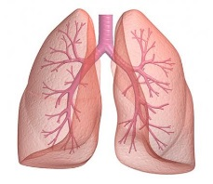
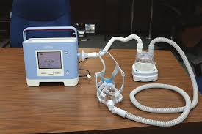
Pulmonary Manifestations
Respiratory symptoms may include nocturnal hypoventilation and sleep disordered breathing
May be monitored with pulmonary function tests (FVC in seated and supine position)
Management is with non-invasive ventilation – BiPAP/Trilogy

Slide 15

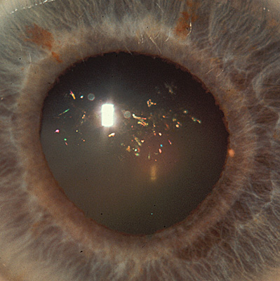
Christmas Tree Cataracts
Atypical cataract of needle-like material causing a diffractive phenomenon leading to their appearance
Can be removed to restore normal vision

Slide 16
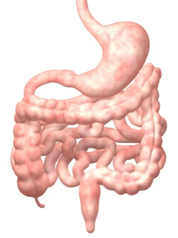
GI Manifestations
Aggressive management of GI dysmotility and constipation to avoid pseudo-obstruction
  MiraLAX
  Metoclopramide
Alternating diarrhea and constipation can also be an issue and requires a gentle touch

Slide 17
Neuropsychiatric
“Myotonic Personality” - apathy
Central hypersomnolence
  Pharmacologic management
Cognitive decline
  Support

Slide 18
Endocrine Issues
Monitor for:
  Diabetes
  Thyroid dysfunction
  Hyperlipidemia
  Erectile dysfunction
  Infertility (male and female)

Slide 19
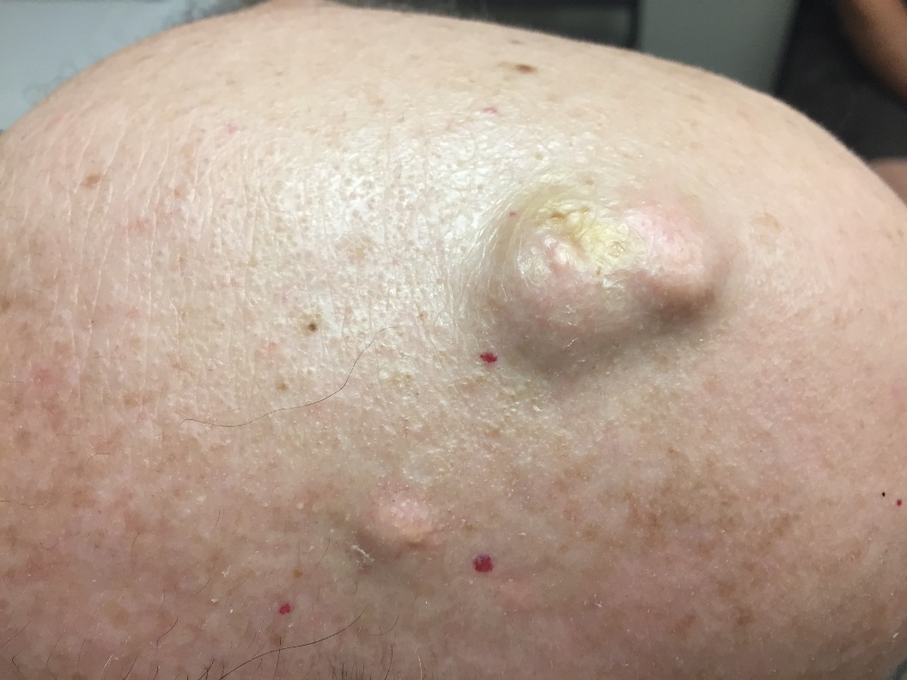
Pilomatricoma
Benign skin tumor associated with hair follicle
Most common on head and neck
Often multiple in DM1
Very rarely may be malignant

Slide 20
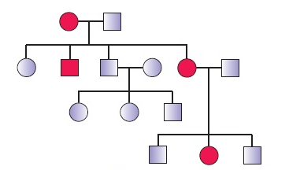
Pregestational Diagnosis
Important to educate patients and families for family planning about what possibilities are available
May inform a decision for genetic testing in younger generations

Slide 21
Clinical Differences Between DM1 and DM2
DM2 tends to be milder
Later onset
Weakness is proximal – in the hip flexors and neck flexors, the face is often spared
A congenital form has not been described
Clinical myotonia is often absent

Slide 22
Clinical Similarities Between DM1 and DM2
Systemic manifestions:
  Cardiac
  Cataracts
  Sensitivity to anesthesia
  Endocrine issues
  Fertility issues
  Cognitive/Neuropsychiatric issues
  Pilomatricoma

Slide 23
Myotonic Dystrophy
The story of how a genetically simple disease has come to be understood from a genetic (population and individual) and pathophysiologic standpoint
This knowledge has led to an ability to provide clinically relevant genetic counseling and directed clinical care and in the near future may lead to meaningful therapeutic interventions

Slide 24
DM1 is a Trinucleotide Repeat Disorder
The trinucleotide repeat disorders are a family of genetically simple neurological disorders with multiple known inheritance patterns
When the repeat length exceeds the stable threshold, the repeat becomes unstable and may undergo intergenerational expansion
Notes:
Trinucleotide repeat mutations have only been described in neurologic diseases
Dynamic mutation: not all disease mutations are stably transmitted from parent to offspring
DRPLA = dentatorubropallidoluysian atrophy
Kennedy disease = SBMA = spinobulbar muscular atrophy

Slide 25
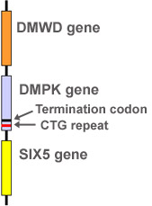
DM1
CTG repeat located
in the 3’ untranslated region of the DMPK gene
on chromosome 19
Notes:
DMPK gene encodes the myotonin protein kinase protein

Slide 26

Anticipation in DM1
Longer CTG repeat lengths lead to earlier onset and more severe phenotype
  Normal: 5-37
  Premutation: 36-50
  Protomutation: 50-100
  Classic Disease: 100-1000
  Severe phenotype: >1000
Notes:
People with repeat length in the protomutation may be mildly affected – often only with cataracts or abnormalities detected by slit lamp examination
Genetic testing/diagnosis is commercially available with direct analysis of the size of the CTG repeat by Southern blot analysis on a blood sample

Slide 27
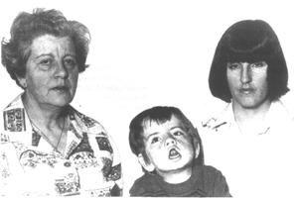
Anticipation
Repeat length increases in successive generations leading to younger age of onset and more severe phenotype
Notes:
*Anticipation has not been described for SCA 6, which has a GAA repeat that is not unstable during generational transmission; however cross-sectionally, age of onset and disease severity correlate with repeat length

Slide 28
Population Genetics
(CTG)₅ is the most common allele
How does a disease that decreases reproductive fitness remain in the population at a steady rate?
C T G C T G C T G C T G C T G
G A C G A C G A C G A C G A C

Slide 29
Population Genetics
Healthy individuals with 2 alleles in the normal range who have an allele with ≥ 19 repeats will preferentially pass on this allele
  This maintains a reservoir for potential disease
Trimodal distribution of normal repeat lengths:
  5 repeats: stably inherited
  9-18 repeats: stably inherited
  19-37 repeats: tendency toward increasing allele length with frequent de novo expansions into the premutation range
Notes:
Meiotic drive = preferential selection of an allele during meiosis leading to over-representation of the allele in gametes (>50%)

Slide 30
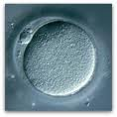
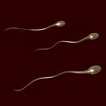
Parental Bias in DM1
Sperm: repeat lengths of 40-80 are likely to expand
  Change from minimal (protomutation) to classical DM1 is more often paternally inherited
Eggs: only repeat lengths of >100 are likely to expand
The largest repeat expansions tend to occur in eggs
  Most cases of congenital myotonic dystrophy are maternally inherited

Slide 31
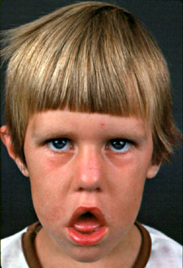
Congenital Myotonic Dystrophy
Marked facial weakness
Hypotonia, may disappear
Clinical myotonia absent
Neonatal respiratory distress
Feeding difficulties
Developmental delay
Mental retardation (nonprogressive)
Maternally inherited
Large repeat expansions
Notes:
If there is clinical myotonia in the delivery room then the diagnosis is more likely to be a non-progressive myotonia

Slide 32

Pathogenesis
How does a mutation in a noncoding region of a gene lead to so much widespread havoc?
Is the pathology related to the DMPK protein?

Slide 33
Digression – DM2
A strikingly similar disorder characterized by weakness as well as all of the other systemic manifestations reported for DM1
  Pattern of weakness is different than in DM1 – Early weakness in the neck flexors and hip flexors
  DM2 is generally a milder disease
Notes:
Congenital myotonic dystrophy and the associated cognitive findings have not been convincingly reported in DM2
ZNF9 = zinc finger protein 9
The correlation between repeat length and disease severity is less clear in DM2 than in DM1 and anticipation has not been reliably demonstrated. This may be in part because of somatic instability of CCTG repeat length: repeat length increases with age of the individual (as the affected individual ages, the repeat length increases). In addition, alleles in different tissues demonstrate different repeat lengths. This makes these neat and clean clinical correlations very difficult.

Slide 34
DM2
DM2 is caused by an expanded CCTG repeat in the ZNF9 gene (chrom 3)
The repeat length is much longer
The repeat length does not correlate with phenotype
Anticipation is not clearly demonstrated
The repeat length may not be stable over lifetime

Slide 35
Pathogenesis of DM1 and DM2
The expanded CTG or CCTG allele is transcribed into RNA, which contains long sequences of CUG or CCUG RNA repeats
These RNA repeats cause the RNA to fold into a hairpin shape
Mutant RNA’s accumulate in nuclear foci and disrupt the regulation of alternative splicing of mRNA

Slide 36
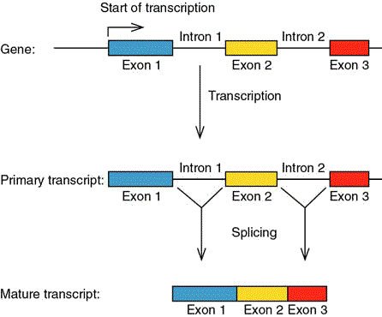
RNA Processing
Expanded RNA repeats create a gain of function mutation leading to aberrant regulation of alternative RNA splicing
Notes:
Alternative splicing: different splicing patterns of pre-mRNA can generate different mature mRNA leading to the translation of different proteins; splicing of pre-mRNA into mRNA is regulated by cell type and developmental stage
In myotonic dystrophy there is a failure to switch from embryonic to adult splicing patterns in a subset of transcripts, such that embryonic forms of certain proteins are expressed. These embryonic forms do not function properly in adult tissue.

Slide 37
RNA Processing Explains Symptoms
  Aberrant (retained embryonic) splicing of CLC1 pre-mRNA leads to loss of CLC1 mRNA and protein in DM1 skeletal muscle tissue, causing a chloride channelopathy in muscle
Notes:
CLC1 (CLCN1) encodes the main chloride channel found on the skeletal muscle membrane – normal skeletal muscle has a high resting chloride conductance and reduction in conductance (caused by the absence of this channel) leads to electrical instability and myotonia (failure of muscle relaxation)
Plausible explanations for cardiac findings and insulin resistance also exist

Slide 38
RNA Binding Proteins Are The Culprits
2 RNA binding proteins were identified because of their propensity to bind to CUG RNA repeats
CUG-BP1 and MBNL1 are mutually antagonistic regulators of a subgroup of alternative splicing events that are affected in myotonic dystrophy
Notes:
CUG-BP1 = CUG binding protein 1
MBNK1 = Muscleblind-like protein 1

Slide 39
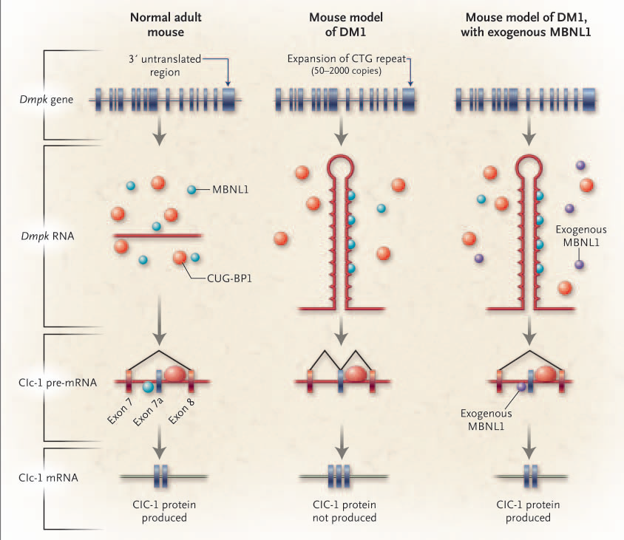
NEJM 355;17:1825
Notes:
Adding MBLN1 restores the ability to splice the mRNA into adult forms, leading to production of the CLC1 protein and abolition of myotonia in this mouse model. Overexpression of MBNL1 did not reverse histologic changes in muscle; so this is not the whole story (Proc Natl Acad Sci USA 2006;103;11748.)
The next challenge will be to increase the specificity of this intervention, because there is danger in overexpressing MBNL1 in an unregulated way.

Slide 40
Thank you!

