Slide 1
Advancing treatments for the Myotonic Dystrophies
Myotonic Conference Philadelphia September 2019
Matt Disney, PhD.
Professor Scripps Research
Founder, Expansion Therapeutics

Slide 2
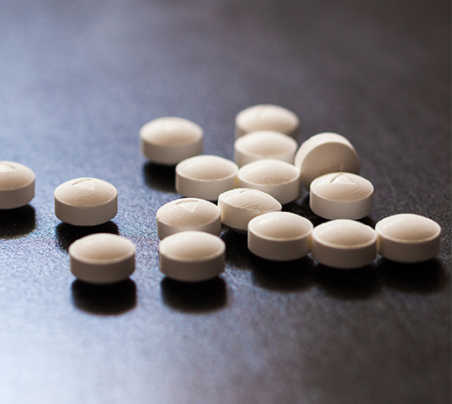
Expansion develops small molecule medicines
ADVANTAGES
Tried and true small molecule medicine like aspirin.
You can take as a pill.
The contents of the pill can penetrate many tissues from heart to skeletal muscle to brain.
Chemists can make many small molecules to fix a problem that can emerge.
Routine Medicine

Slide 3
We address severe RNA-mediated diseases
PIPELINE
in vitro Biochemical
in vitro Cell
in vivo Animal
Dev. Candidate
1st in Human
DM1
DM2
Program 3
Program 4

Slide 4
DM1 disease mechanism
0, 99, 158
255, 102, 0
166, 166, 166
Illustrative
Text
Text
Text
Text
CUG expansion repeats sequester Muscleblind, limiting its availability for normal gene splicing
50- 1,000+
MB
MB
G
C
U
U
Muscleblind Regulates splicing of hundreds of mRNAs
C
G
MB
MB
G
C
U
U
C
G
MB
MB
G
C
U
U
5’
NON-CODING
DMPK
NON-CODING
C
G
NON-CODING
3’
3’

Slide 5
Expansion Therapeutics mechanism
Storyboard 5
0, 99, 158
255, 102, 0
166, 166, 166
Illustrative
Text
Text
Text
Text
50- 1,000+
Our molecule blocks binding
Now available for normal pre-mRNA splicing
G
C
U
U
C
G
MB
G
C
U
U
An effective compound improves defects on RNA, protein, and phenotype
C
G
G
C
U
U
5’
NON-CODING
DMPK
C
G
NON-CODING
3’

Slide 6
Tool compound improves disease in a mouse model
% Wildtype Splicing in Mice: Clcn1 ex7a
WILD TYPE (FVB)
DM1 (FVB-HSALR)
100%
75
50
PK/PD relationship favorable for drug development
25
0
PBS
Drug
PBS
Drug
5

Slide 7
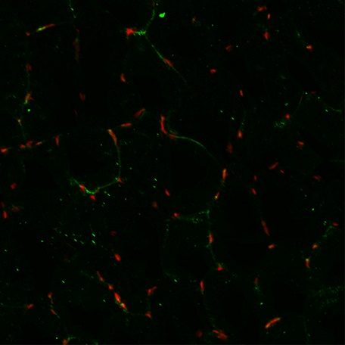
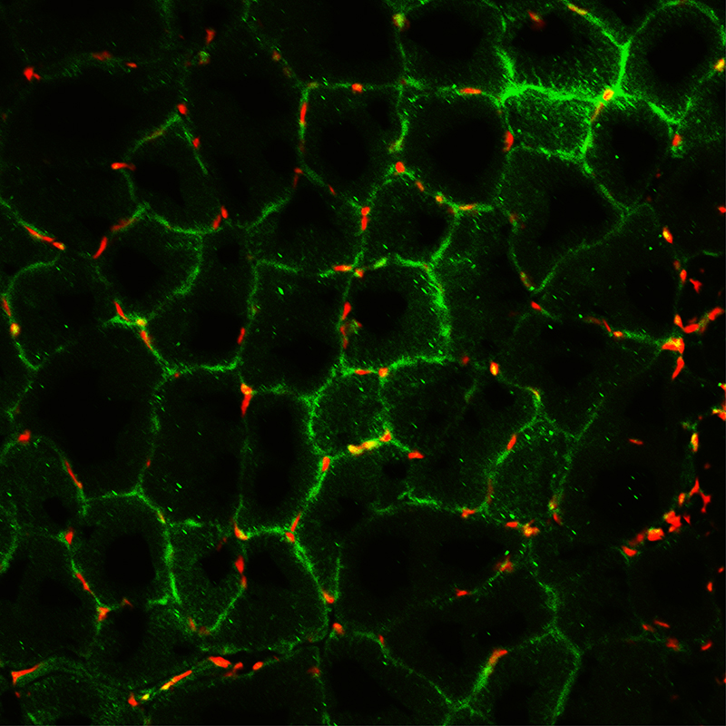
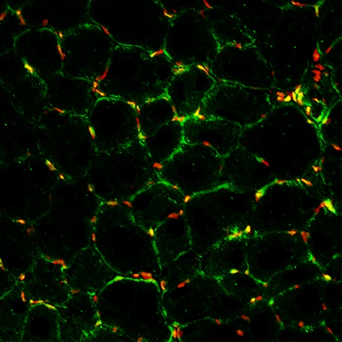
Tool compound improves disease in a mouse model
DM1
WILD TYPE
DM1 treated with Drug
Green: chloride channel protein
Red: DNA (nucleus)
6

Slide 8
Tool compound improves disease in a mouse model
UNTREATED DM1 MOUSE
Day 1: 9/9 showed action myotonia
Day 31: 9/9 showed action myotonia
7

Slide 9
Tool compound improves disease in a mouse model
TREATED DM1 MOUSE
Day 1: 9/9 showed action myotonia
Day 31: 0/9 showed action myotonia*
*blinded action test

Slide 10
Medicines must be safe and effective
Drug Design
Make the drug
Test in cells
Test in animals
Ensure the drug is safe
Test in test tube

Slide 11
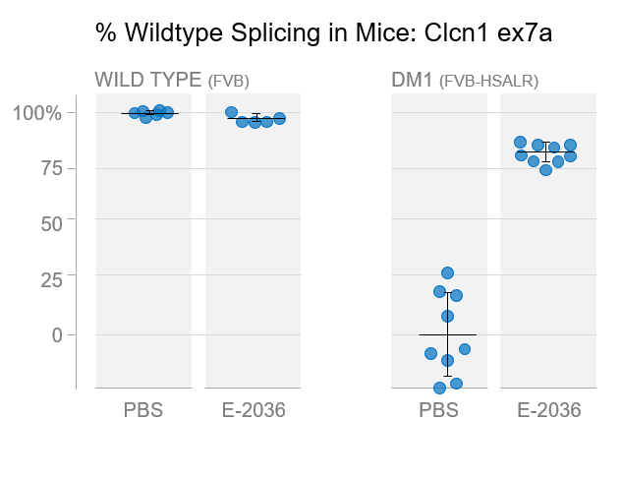
Summary
DATA
PLATFORM
EXPERTISE
InfoRNA
ChemClip
C-ChemClip
ChemCleave
Leveraging 20 yrs. of experience on targeting RNA with small molecules
Broad expertise in chemistry → biology → medicine of DM
Advancing therapeutics for both DM1 and DM2
ChemClick
Developing small molecules targeting repeat expansions
Focus on both DM1 and DM2
Proprietary platform and enabling tools
Classical small molecule approach
Can cleave RNAs with small molecules
Notes:
Not interested in
Alzheimers and parkinsons.
Modulate those pathways.
Alpha synuclein; tao; flush out thinking.
ADPD

Slide 12
Lack of muscleblind causes system-wide defects
0, 99, 158
255, 102, 0
166, 166, 166
Text
Text
Text
Text
Myotonia
Muscle strength
Insulin Resistance
Heart Defects
Sleep defects
Learning/Memory
Chloride channel
50- 1,000+
Bin1, Cacna1a
MB
Insulin receptor
G
C
Troponin T
U
U
C
G
Csnk1d
MB
G
C
Tau
U
U
C
G
MB
G
C
U
U
5’
NON-CODING
DMPK
C
G
NON-CODING
3’

Slide 13
Tool compound improves disease in a mouse model
CASI score¹: Composite Alternative Splicing Index
Normal
DM1
Treated
Severe DM1
0.5
1. This score reflects the average mis-splicing across 10 Muscleblind-dependent splicing events conserved from mouse to human. The higher the score, the more the mis-splicing. A similar score has been developed for use with human tissue as a biomarker.
0.4
0.3
0.2
0.1
Normal
0.0
Wild Type
HSALR
HSALR + Drug
DETAIL
12

