Slide 1
The Christopher Project
Project Overview and Highlights

Slide 2


The Christopher Project
A comprehensive survey of patients and family members/caregivers living with myotonic dystrophy in the U.S.A. and Canada
A collaborative partnership between patients and families, patient advocacy organizations, and clinical centers of excellence in myotonic dystrophy

Slide 3
Project Aims
To understand the complexity of myotonic dystrophy
To explore the unmet needs of patients and family members/caregivers
To complement existing research and therapeutic development programs

Slide 4
Methodology
Collaborative approach used in study and survey design
Extensive consultation with industry
All survey materials were pilot tested with interview feedback
High data quality control standards applied throughout the study
All data anonymized and stored securely using best practices
Rigorous statistical analysis applied using IBM SPSS software

Slide 5
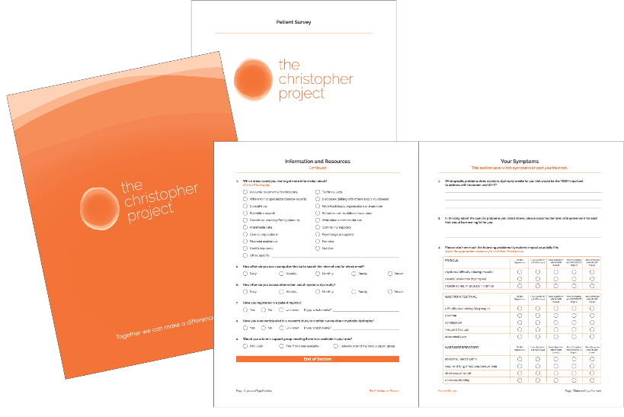
Survey Design
Paper-based Patient Survey with follow-on Family Member/Caregiver Survey
Included over 100 questions in the following domains:
Physical Symptoms Current Health Diagnostic Experience Information & Resources Health Care Experience | Managing Daily Life Healthcare Insurance Family Member/ Caregiver Experience Demographics

Slide 6
Survey Distribution
4,000 Patient Surveys mailed out across the U.S.A. and Canada through MDF, MDA, and MDC
1,000 follow-on Family Member/Caregiver Surveys mailed out directly through patient respondents
Administered under human subjects ethics approval in U.S.A. and Canada

Slide 7
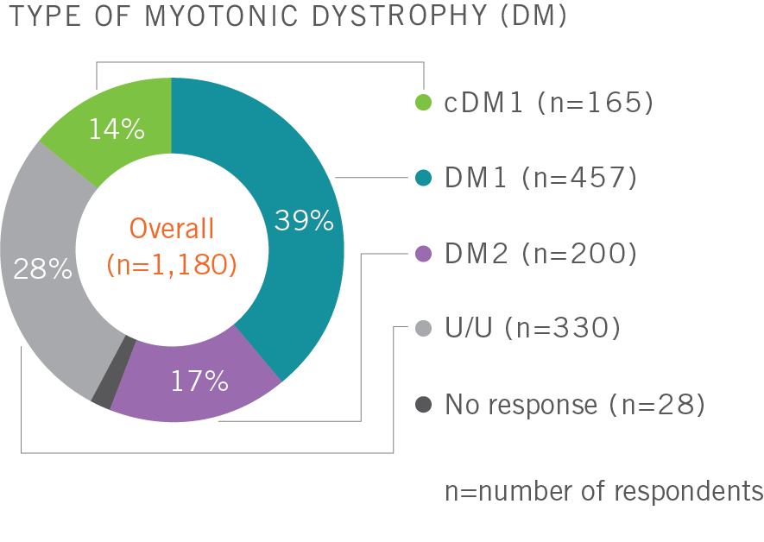
Survey Respondents
1,180 qualified patient responses including representation across all disease types (DM1, cDM1, and DM2)
402 qualified family member/ caregiver responses with direct linkage to patient respondents

Slide 8
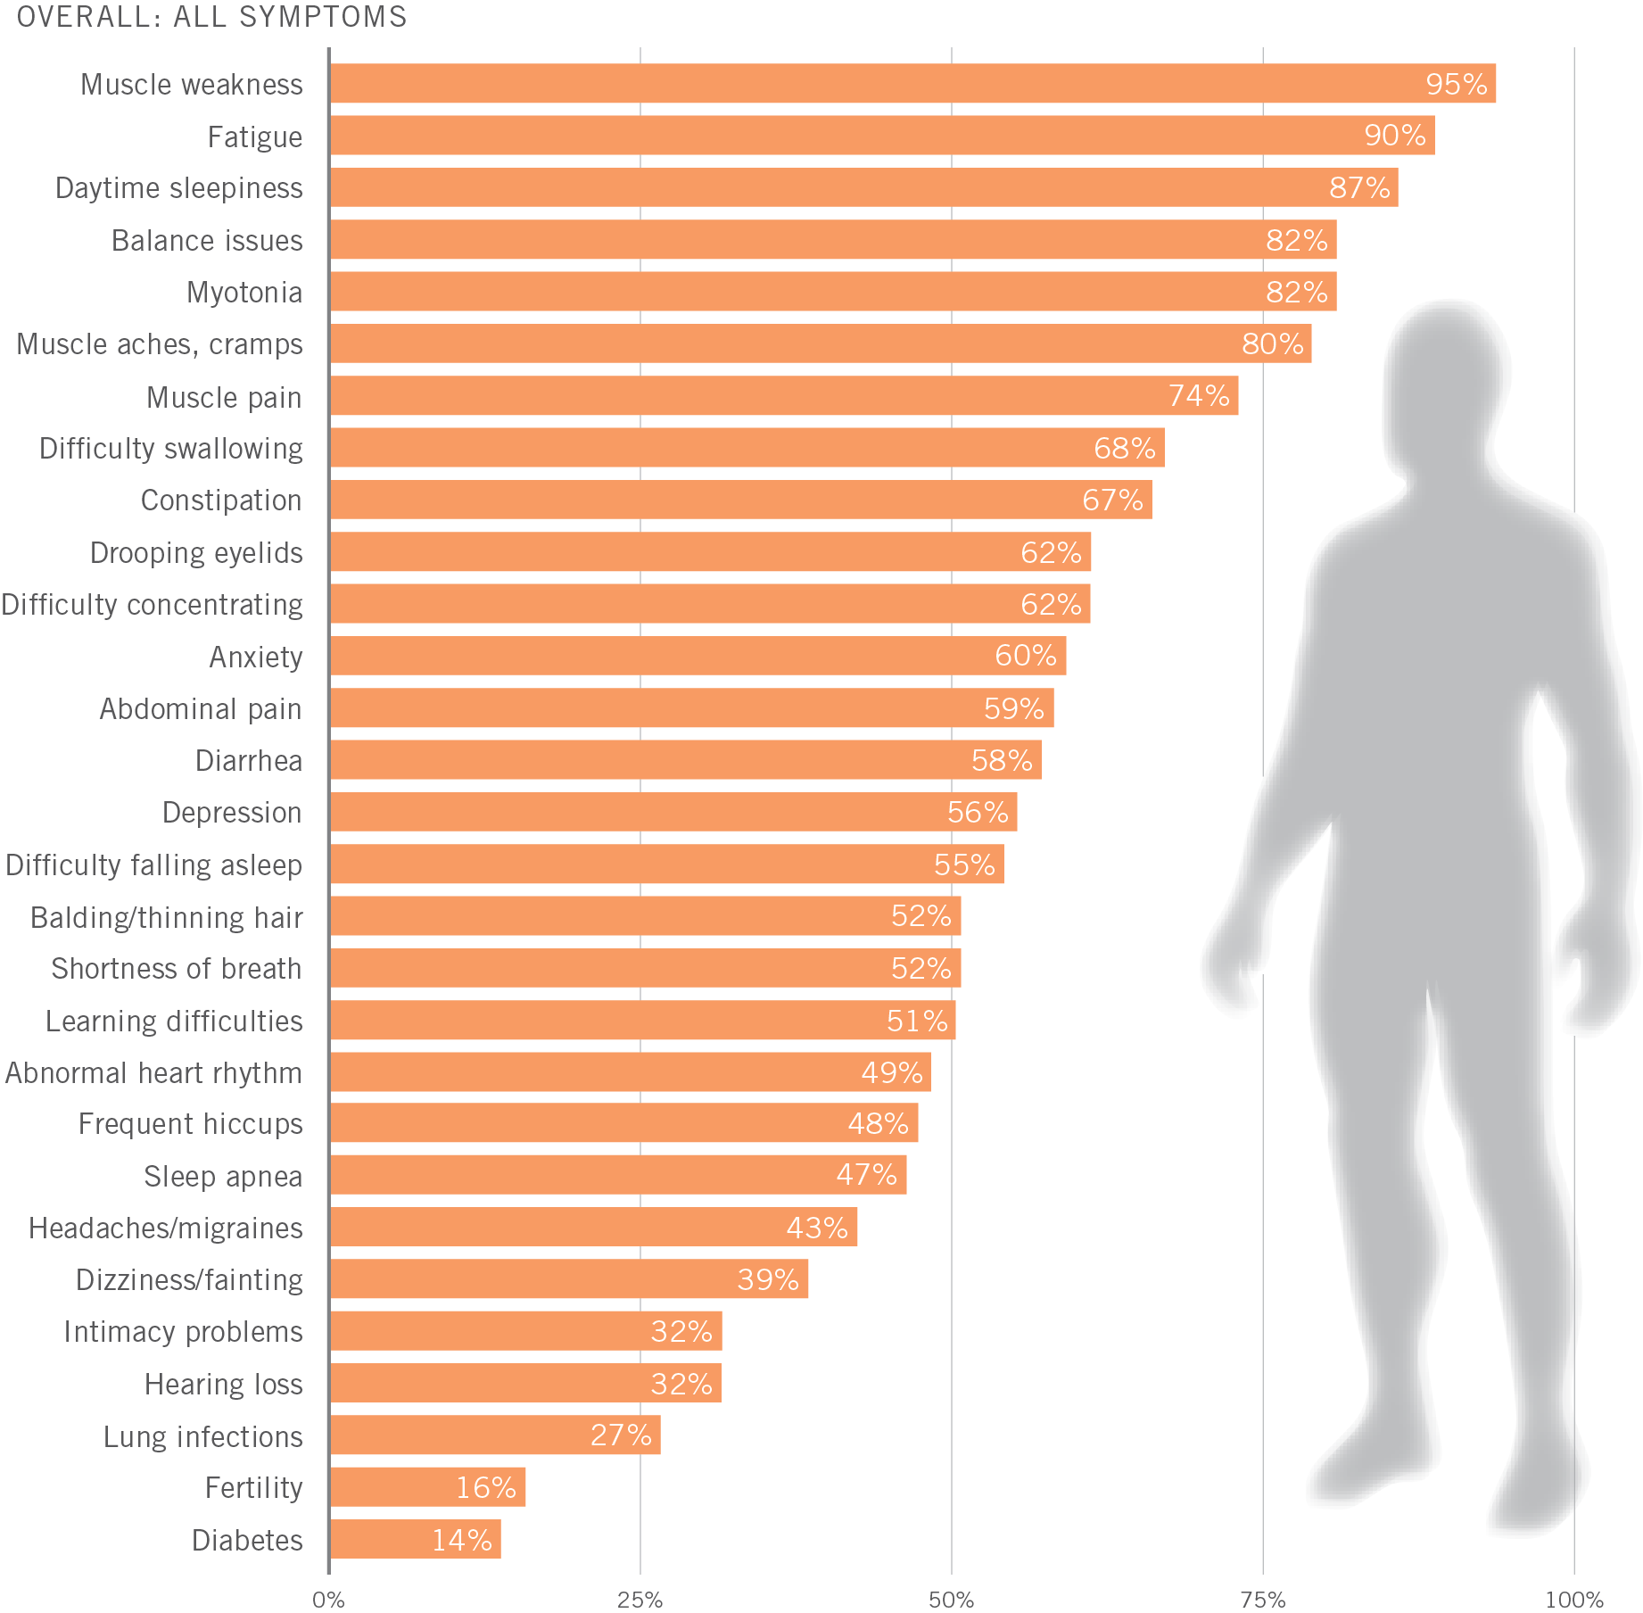
Select Results: Symptom Prevalence
Myotonic dystrophy is highly variable and affects many different parts of the body
Symptoms place significant burdens on patients and families, not just physical
Major implications for daily life, clinical care, and therapeutic intervention
Percentage of overall respondents who reported having a particular symptom

Slide 9
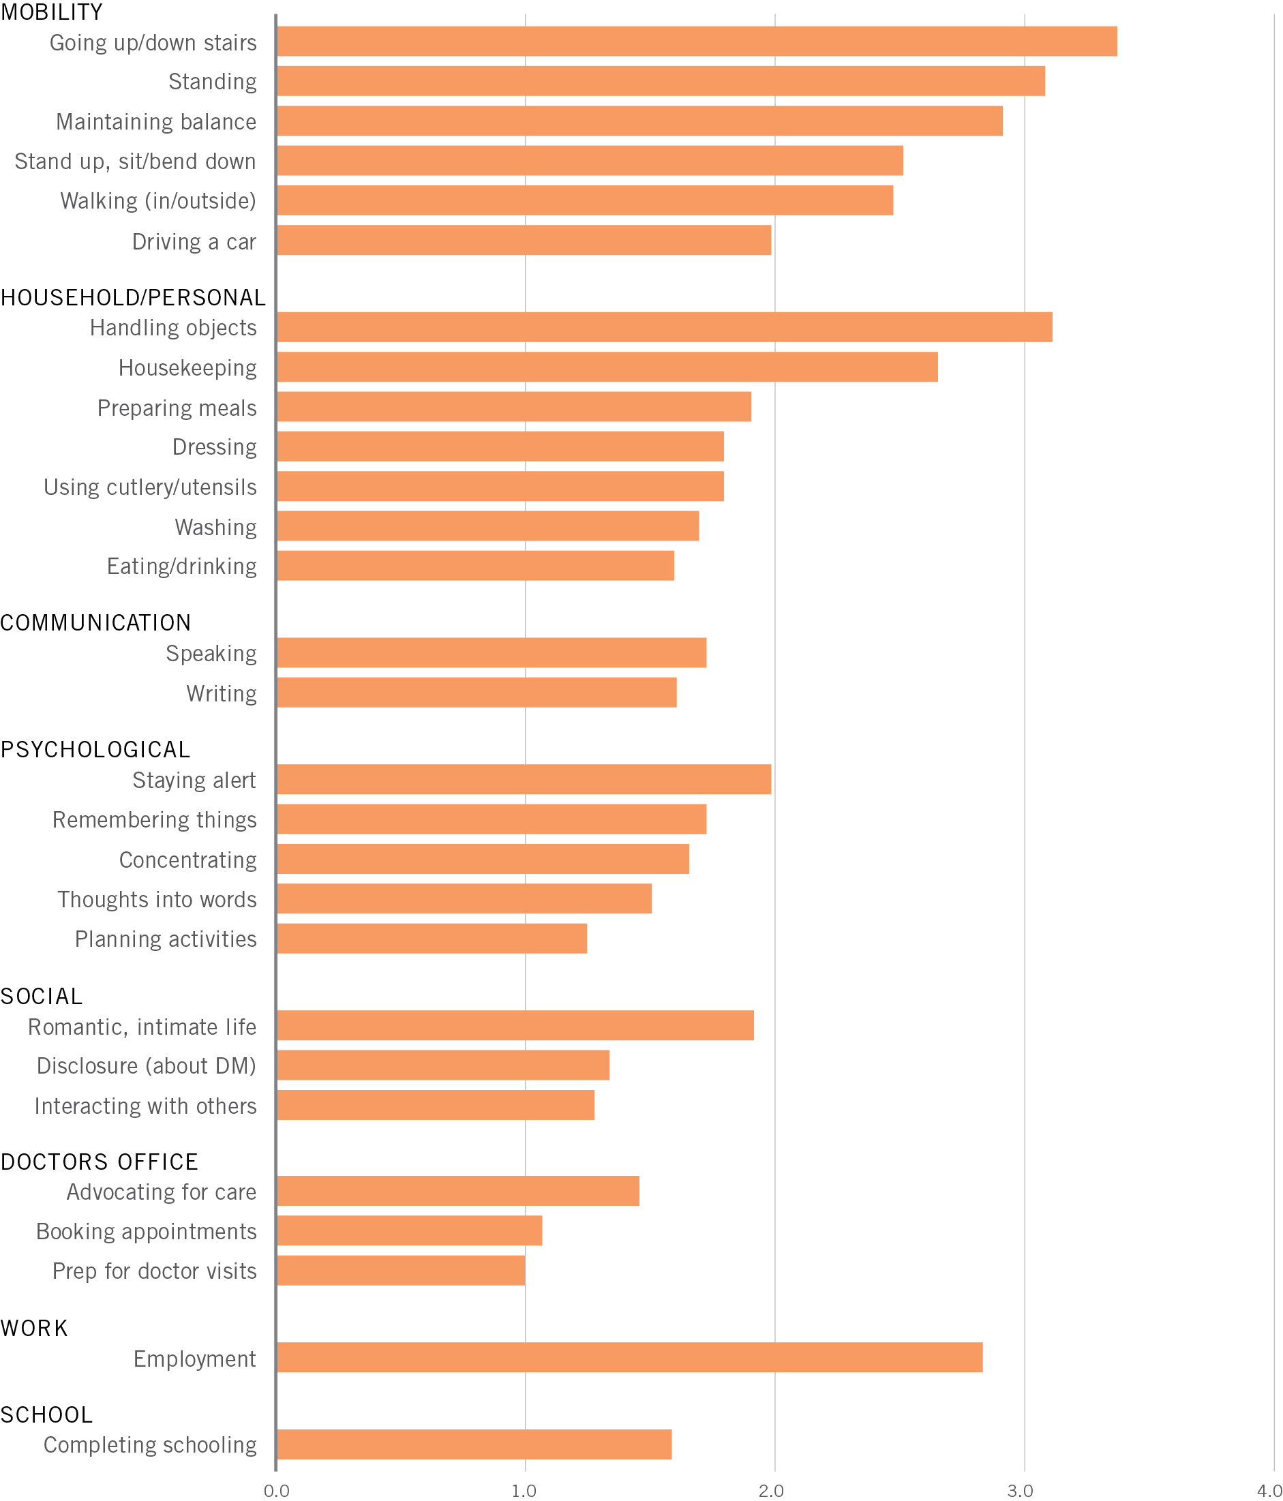
Select Results: Managing Daily Life
ACTIVITIES
Performing daily activities is challenging for people living with myotonic dystrophy
Getting around effectively can be particularly difficult
Major implications for obtaining and retaining employment
Results shown are weighted by the reported level of challenge for each activity
NOT A CHALLENGE
MINOR CHALLENGE
MODERATE CHALLENGE
MAJOR CHALLENGE
UNABLE TO PERFORM

Slide 10
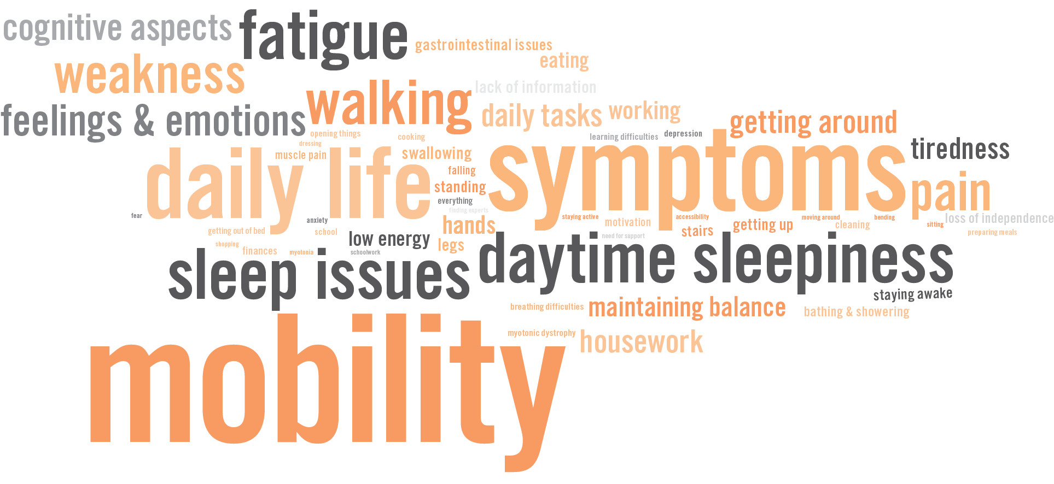
Select Results: Biggest Obstacles in Managing DM

Slide 11
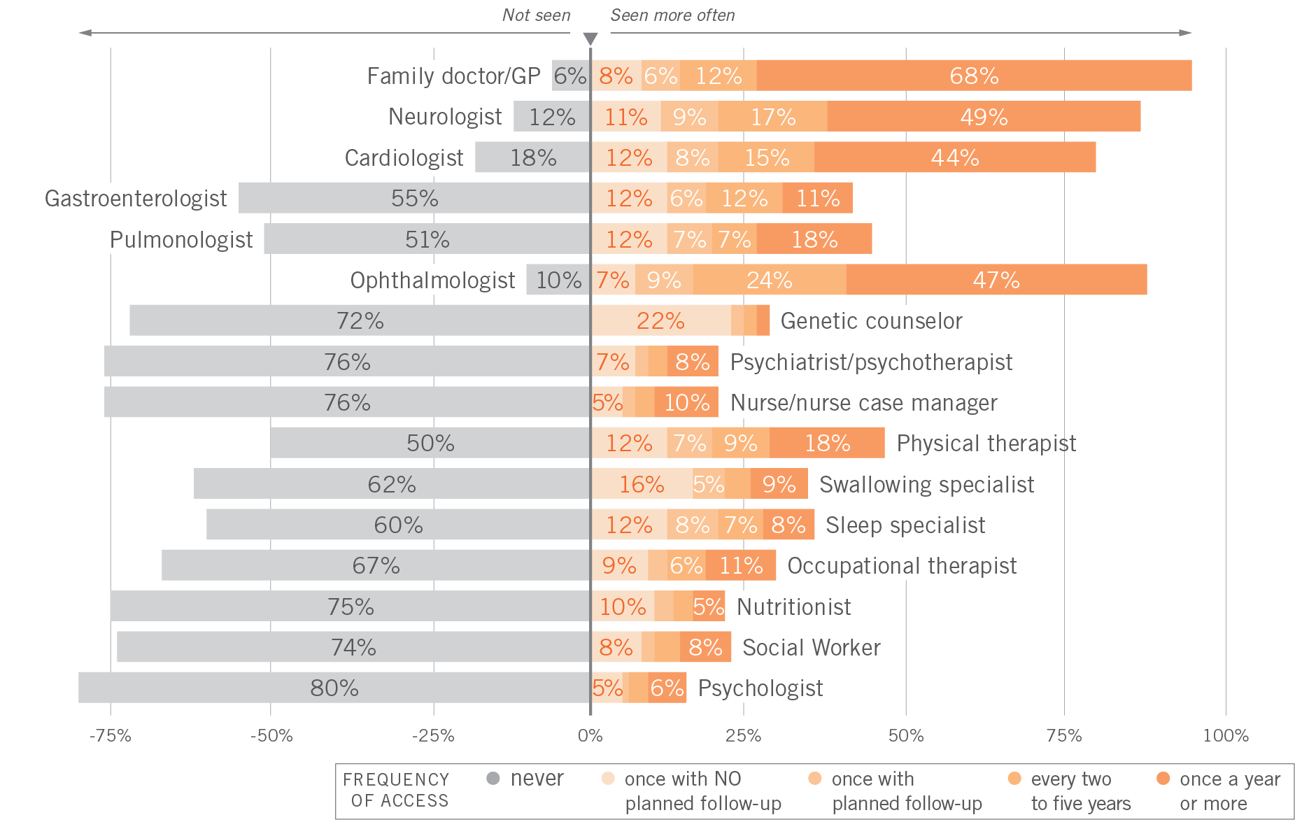
Select Results: Healthcare Access
Access to different healthcare providers varies among patients
There are some critical gaps in healthcare access and clinical care
Effective disease management requires a comprehensive system of care

Slide 12
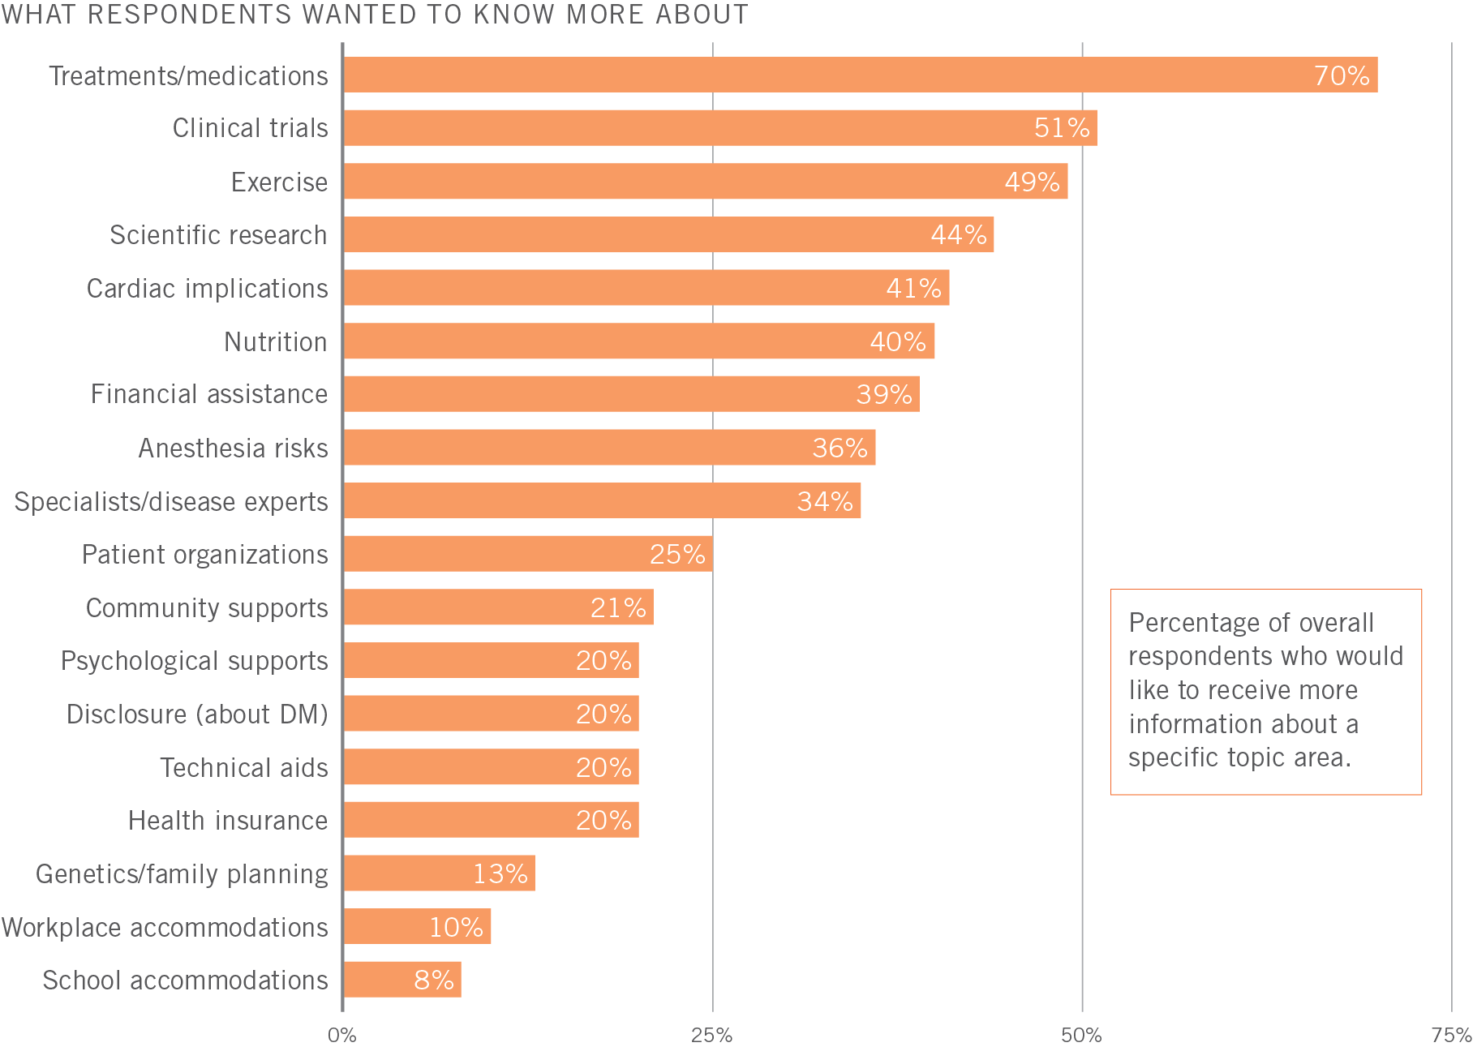
Select Results: Information Needs
Information is essential for patients and families
Most respondents want to know more about treatments and medications
Over half want to know more about clinical trials

Slide 13
Major Project Outcomes
Delivers critical insight into what it’s like to live with myotonic dystrophy—directly from the patient and family member/caregiver perspective
Highlights opportunities to improve health outcomes and develop therapies that address the significant disease burden and unmet needs identified in the study
Provides a valuable resource for patient advocacy organizations, scientists and clinical investigators, biotech and pharmaceutical companies, and regulatory bodies

Slide 14
Reporting and Publication
The Christopher Project Report to the Myotonic Dystrophy Community
Comprehensive 75-page printed report available by request: support@christopherproject.org
Descriptive results of all survey questions presented overall and by type of DM
Distributed to all research participants in Spring 2019 and more broadly to patients, families, advocacy organizations, academic investigators, and industry
Journal article: Hagerman KA, Howe SJ, Heatwole CR; Christopher Project Reference Group. The myotonic dystrophy experience: a North American cross-sectional study. Muscle Nerve. 2019 Jan 24. doi: 10.1002/mus.26420.
10-page summary publication
Selected overall results and comparisons between DM1/DM2 and DM1/cDM1

Slide 15
Data Access
The Christopher Project dataset includes over 200,000 data points and is available to qualified investigators
Inquiries and data access requests can be made to support@christopherproject.org
For more information including supplementary materials visit www.christopherproject.org or contact the MDF directly at <email>

